Slide 1
Updates on PSC Forum
Veronica Miller, PhD
PSC Partners Confernce Rochester MN
June 22, 2019

Slide 2
OUTLINE
Forum for Collaborative Research
PSC Forum Members & Sponsors
PSC Regulatory Path
  Challenges & Opportunities
Endpoints Working Group
  Role of Patient Reported Outcomes
Contribution of Patient-Level Data

Slide 3

Guiding Principle
Once new drug candidates and therapeutic strategies are identified, their efficient and safe development is in the best interest of all stakeholders, most of all, the patients.
“The Forum accelerates drug development by increasing
efficiency through collaboration, not by lowering standards.”
Veronica Miller PhD, Executive Director, The Forum for Collaborative Research

Slide 4

The Concept
THE FORUM
Enhanced clarity
Innovation
Collaboration
Increase Efficiency
Regulators
ONE TABLE
Patients
Industry
Decrease Uncertainty
Redundancy
Development time
Risk
Academia
“Starting with HIV, the Forum consistently and effectively applies the multi-stakeholder model to advance the development path for new treatments in multiple disease areas. ” Eric A. Hughes, MD, PhD, Development Unit Head, Novartis Pharma AG

Slide 5
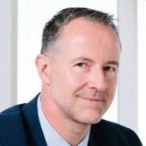
Characteristics
Non-competitive
Safe environment
Independence
Neutrality
Transparency
Information democracy
Synergy vs duplication
Equal voice
The traditional process:
Single sponsor communicating
independently
with single
regulatory agency
The Forum process:
All sponsors
communicating
at the same
time with multiple
regulatory agencies
- VS -
“The Forum bring together stake holders from
around the globe with cross-Atlantic and -Pacific
perspectives to reduce interagency discordance.”
Laurent Fischer MD, Senior VP, Allergan

Slide 6
Disease Areas
HIV Forum
HCV Forum (completed)
Liver Forum (NASH)
CMV Forum/transplantation
HBV Forum
PSC Forum
Rare Diseases Forum

Slide 7
Synergy Opportunities
PSC Forum ↔ Liver Forum
  Industry sponsors
  Biomarker validation
  Placebo-arm cohort
  Overlap – regulatory experts
PSC Forum ↔ Rare Dis. Forum
  Challenges w small patient populations
  Innovation in clinical trial design
  Use of natural history studies as “controls”

Slide 8
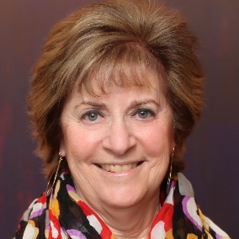
The PSC Forum (2017-present)
Agency EU
European Medicines Agency
Agency US
US Food and Drug Administration
Pharmaceutical Industry
Allergan
Blade Therapeutics
Bristol Myers Squibb
ChemomAb Ltd.
Conatus Pharmaceuticals, Inc.
CymaBay Therapeutics
Durect
Enanta
Gilead
GSK
Intercept Pharmaceuticals
Mirum Pharmaceuticals
Morphic Therapeutic
NGM Biopharmaceuticals
Takeda
Pliant Therapeutics
Respivant
Diagnostic and Other Industry
Covance
HepQuant
TARGET PharmaSolutions
Patient and Community
Representatives
PSC Partners***
PSC Partners/Canada
PSC Support
Professional Societies
AASLD
EASL
Other Organizations
IPSCSG
Productivity in maximizing utility of databases and natural history cohorts
Build collaborations across players involved in various types of data gathering
Agility to adapt trial design to maximize patient-centric clinical research
Support development of patient reported outcomes
Evolve consensus on appropriate inclusion and
exclusion criteria
Efficiency in defining relevant trial endpoints
Consider novel areas of focus, such as fluctuations in
alkaline phosphatase and liver stiffness
“PSC is an excruciatingly challenging unmet medical need. The PSC Forum helps us align our respective visions and efforts.
There is no question that the patient voice has the real and substantial impact needed for patient-centric drug development ”
Ricky Safer, CEO, PSC Partners Seeking a Cure

Slide 9
PSC Forum Steering Committee

Slide 10
PSC Forum Project Manager
Jessica Weber MPH RN

Slide 11
Strategic Restructuring – PSC Forum Sustainability
Challenge
  Few companies actively involved in PSC R&D
Solution
  Two-for-one membership fee
    Liver Forum/NASH + PSC Forum
Advantage
  Attract more companies into PSC space

Slide 12
Liver/NASH & PSC Forum Sponsors

Slide 13
PSC Forum Sponsors

Slide 14
PSC Forum Sponsors

Slide 15
PSC Forum Sponsors

Slide 16
PSC Forum Sponsors

Slide 17
PSC Forum Sponsors

Slide 18
PSC Regulatory Path
Challenges & Opportunities

Slide 19
How a patient feels, functions and survives
Benefit > Risk

Slide 20
How a patient feels, functions and survives
Convincing Evidence
Benefit > Risk
Whose perspective?

Slide 21
Clinical
Endpoint
“Hard”
Surrogate
Endpoint
Disease Intermediate
PREDICT

Slide 22
PSC Forum Role?
Informal “harmonization” between FDA and EMA perspectives
  Increase efficiency in the drug development process
Patient input from both sides of Atlantic

Slide 23
Key Regulatory Agencies
US Food & Drug Administration
  No PSC specific draft guidance yet
European Medicines Agency
  “Reflection Paper” for NASH, PBC and PSC (2018)

Slide 24
PSC Forum providing a response to EMA
Issues on requirement for liver biopsy
Issues on biomarkers (e.g. ALP) as dx and endpoint markers
Need for clarification of definitions (e.g. Strictures)
Patient inclusion/exclusion criteria
Call for natural history cohort for pediatrics

Slide 25
PSC ENDPOINTS Working Group
Role of Patient Reported Outcome Measures

Slide 26
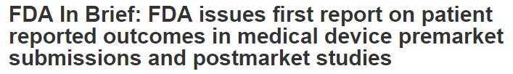
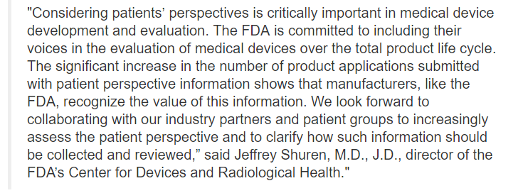

Slide 27
Patient-focused outcome measurement is really about measuring things that are important to patients, such as how a treatment will affect their symptoms, day-to-day functioning, and overall survival.”
“COAs are simply the patient-focused tools that we use as part of our assessments of clinical outcomes, such as how patients feel or function in their daily lives,” notes Papadopoulos. “These measurements of patient outcomes provide essential information about benefits and risks of a drug.”

Slide 28
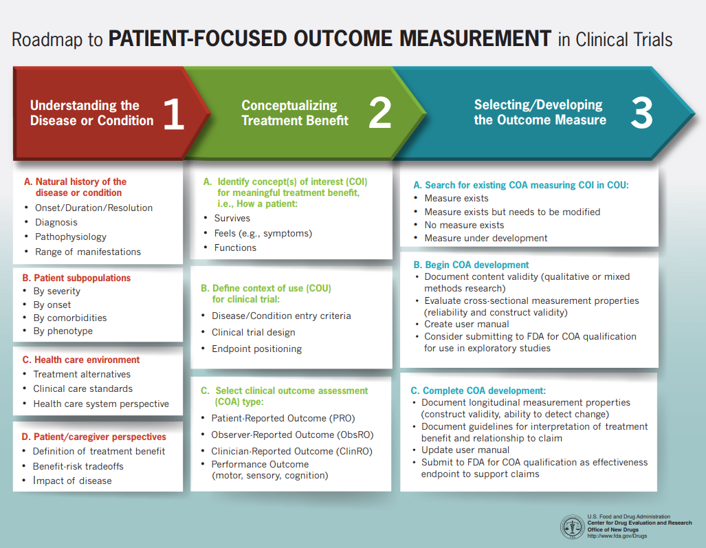

Slide 29
Higher Quality Data
Affords
Increased Regulatory Flexibility

Slide 30
Endpoints/PROM Working Group
Developing White Paper on PSC specific PROMs and its role in the regulatory pathway
Multi-disciplinary/multi-stakeholder working group
Co-chairs:
  Keith Lindor, Steve Rossi
Lead author:
  David Assis

Slide 31
White Paper -- Patient Perspective
Contributors
  Martine Walmsley, PSC Support, UK
  Cynthia Buness, Patient Advocate, USA
  Mary Vyas, PSC Partners Seeking a Cure Canada
  Rachel Gomel, PSC Partners Seeking a Cure, USA
  Ricky Safer, PSC Partners Seeking a Cure, USA
  Sindee Weinbaum, Hetz (Israeli Association for the Health of the Liver), Israel

Slide 32
Considerations
Need for high-quality methodology
Validity of process/output
Need for continuous and meaningful patient involvement
Reflect cultural differences
Mechanism to develop reliable and valid tool for multi-national studies
High quality innovative trial design, including shared placebo pools

Slide 33
Endpoints WG: Next Steps
Facilitate generation of PSC Specific PROMs
  As needed
Continue discussion to integrate other non-invasive endpoints for clinical studies

Slide 34
DATA
Role of Patient-Level Data

Slide 35
Higher Quality Data
Affords
Increased Regulatory Flexibility

Slide 36
Importance of Natural History Cohorts
Understanding patient heterogeneity
Identifying predictors for disease progression paths
Elucidating underlying mechanisms of disease pathogenesis

Slide 37
Collaboration is KEY
No one entity can do this alone
Need all perspectives at the table
Common data elements
Ability to cross-talk between RCT’s and Cohorts

Slide 38
PSC Forum
Support/facilitate establishing an international collaborative effort
  Bring in the industry, patients and regulator perspective in planning and execution

Slide 39
PSC Forum: Placebo Arm Cohort (planned)
Placebo arm data from completed studies
Serve as complementary “natural history cohort”
  Select patient populations vs. clinic based cohorts
  Diversity of approaches necessary in clinical research
Serve to reduce placebo arm burden in future trials

Slide 40
THANK YOU!
veronicam@Berkeley.edu

