Slide 1
PSC Forum
Veronica Miller, PhD
Forum for Collaborative Research
UC Berkeley School of Public Health

Slide 2
The Concept
One table
  Regulators
  Industry
  Academia
  Patients
Increase Efficiency
  Clarity
  Innovation
  Collaboration
Decrease Uncertainty
  Redundancy
  Development time
  Risk

Slide 3
Guiding Principle
Once new drug candidates and therapeutic strategies are identified, their efficient and safe development is in the best interest of all stakeholders, most of all, the patients
Accelerate drug development not by lowering standards, but by increasing efficiency through collaboration

Slide 4
Characteristics
Non-competitive, safe environment
Independence
Transparency
Information democracy
Synergy vs. duplication
Single Sponsor-Single Agency
All Sponsors-Multiple Agencies
Cross-Atlantic perspectives reduce interagency discordance

Slide 5
Results
Advance development of regulatory strategies
  Evolving science & evolving consensus
Generate evidence through collaboration
  Efficient use of data
Provide mechanism for patient-centered drug development
Provide mechanism for innovation in data use and analytics

Slide 6
Forum for Collaborative Research
HIV Forum
Liver Forum
Rare Diseases-IEM
Forum
HBV Forum
PSC
Forum
AH-AALD
Forum?
CMV/Transpl.
Forum
HCV Forum

Slide 7
PSC Steering Committee
Co-Chairs
Keith Lindor
AASLD
Rob Myers
Gilead
Regulatory
Lara Dimick
FDA/CDER/DGIEP
Elmer Schabel
EMA/BfArM
Patient Advocates
Keith Lindor
AASLD
Marco Marzioni
EASL
Ricky Safer
PSC Partners Seeking a Cure
Martine Walmsley
PSC Support
Society
Academia
Christopher Bowlus
UC Davis Medical Center
Gideon Hirschfield
University of Birmingham
Kris Kowdley
Swedish Medical Center
Tamir Miloh
Baylor College of Medicine
Rob Myers
Gilead
Stephen Rossi
NGM Biopharmaceuticals
David Shapiro
Intercept
Industry
Arun Sanyal
Virginia Commonwealth University

Slide 8

PSC Forum Sponsors

Slide 9
PSC Forum Strategy
Start with most urgent questions/issues
Assign multi-stakeholder working groups
Build trust
Allow consensus to evolve
  Always science based
  Identify knowledge gaps and mechanisms to address these
Build more trust
Tackle more challenging issues

Slide 10
Regulatory Perspectives
Regulatory decisions (approve or not approve a drug) is based on benefit and risk considerations
What do we know about the benefit?
  How do we measure it?
  How long will the benefit last?
What do we know about risk (potential harms)
  How do we measure it?
  When could the harm appear? How serious is it?

Slide 11
What is the tolerance for risk?

Slide 18
PSC Forum Work Streams
Clinical Trials
  Inclusion/Exclusion Criteria
  Endpoints (e.g. ALP fluctuations)
Patient Centered Clinical Research
  PRO tools
Data & Data Use

Slide 19
Clinical Trials: Inclusion-Exclusion Working Groups
Underlying IBD
Concomittant therapies
URSO?
Drug Targets
Patient Populations

Slide 20
Gideon Hirschfield
PSC Forum 2

Slide 21
Patient Centered Research
Short-term Working Group
Landscape
  Bring everyone up-to-date

Slide 22
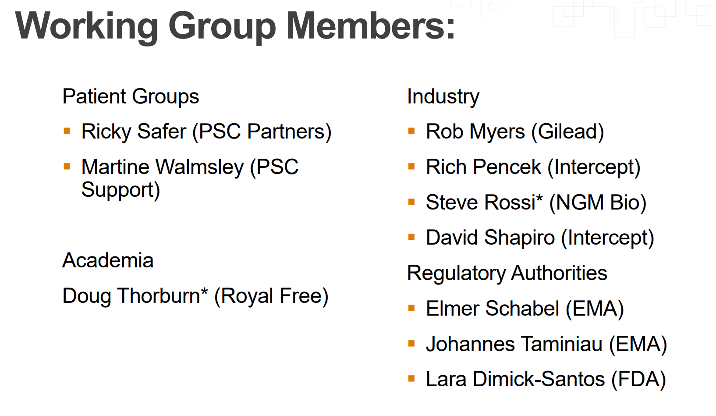

Slide 23
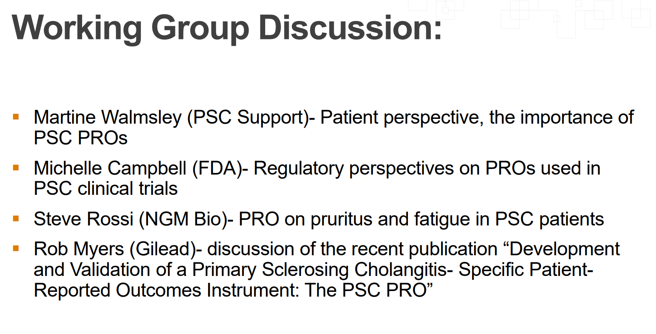

Slide 24
Data & Data Use
Landscape of registries and databases

Slide 25
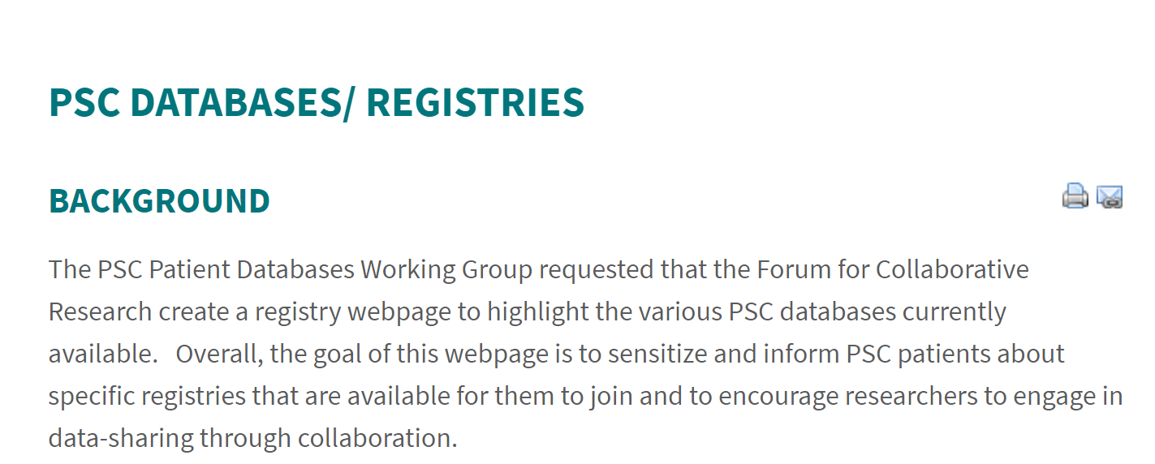

Slide 26
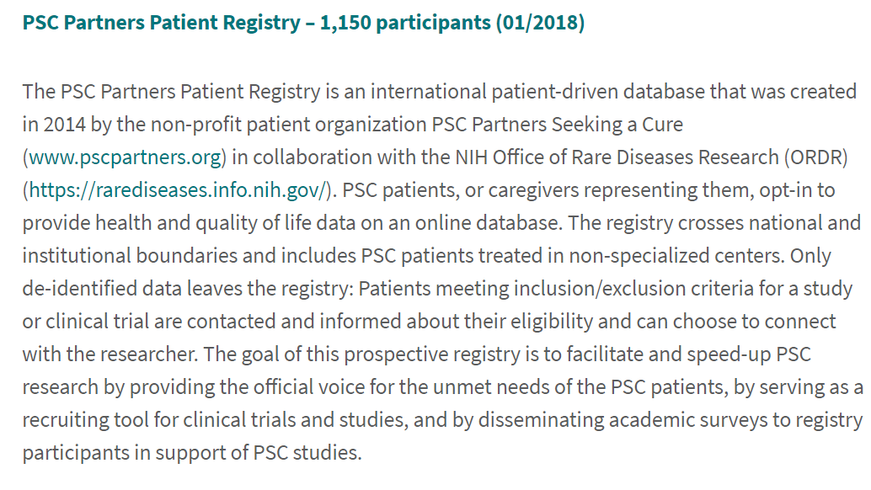
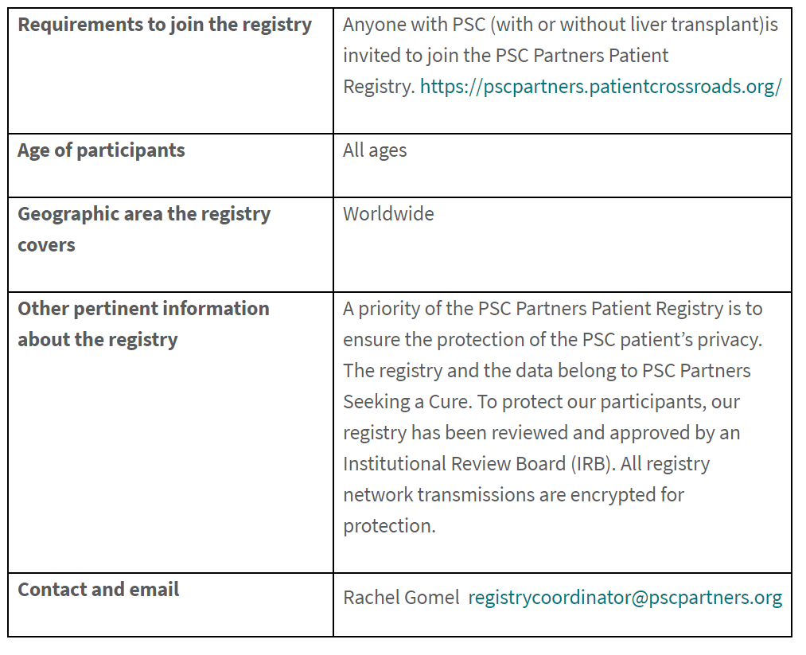

Slide 27
Data Gaps?
What data do we need to meet regulatory purposes?
Identification of surrogate endpoints
Validation of endpoints
Strategy:
  Build synergies amongst existing efforts

Slide 28
Potential Working Groups
Non-invasive diagnostics/Imaging
Pediatrics
Symptom management: ITCH?

Slide 29
Acknowledgement
Forum Staff
  Jessica Weber MPH, RN
PSC Forum SC and Members

