Slide 1
New insights in the natural history of PSC
Cyriel Ponsioen, MD PhD
Department of Gastroenterology & Hepatology
Academic Medical Center
Amsterdam, Netherlands

Slide 2
Disclosures
research grants: Abbvie, Takeda, Dr. Falk
advisory boards: Abbvie, Takeda
speaker’s bureau: Takeda, Abbvie, Dr. Falk, MSD

Slide 3
Epidemiology
0
16.2
12,7
13,6
?
?
?
?
PSC
Prevalence per 100.000 inhabitants

Slide 4
Epidemiology
0
1.3
0.9
0.9
?
?
?
?
Incidence per 100.000 inhabitants
Total: 167 PSC patients
1.2
Boberg et al. 1998
Hurlburt et al. 2002
Bambha et al. 2003
Kaplan et al. 2007
Ngu et al. 2011

Slide 5
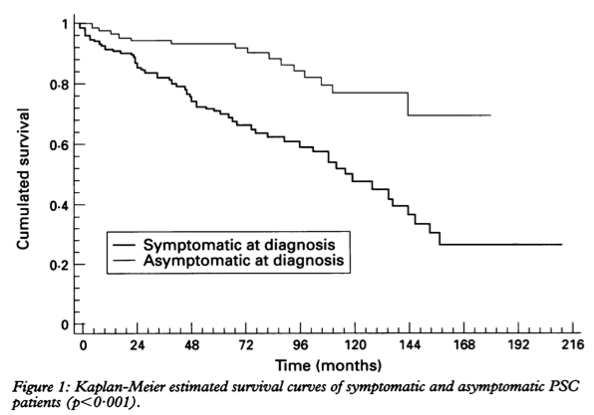
transplant-free survival
Broome et al. Gut 1996:38: 610
Notes:
overall median transplant-free survival=144 months
n=305 from 9 centres of the Swedish Liver Club including Huddionge and Sahlgrenska, the 2 LTx centers

Slide 6
Median transplant-free survival
Wiesner et al. 1989 | 11.9 years
Farrant et al. 1991 | 12 years
Broome et al. 1996 | 12 years
Ponsioen et al. 2002 | 18 years
Tischendorf et al. 2007 | 9.6 years
Claessen et al. 2009 | 14 years
tertiary referral centres
Notes:
median transplant-free survival in >7000 IPSCSG cohort=14.7 years as preseneted a AASLD 2015 in San Francisco

Slide 7
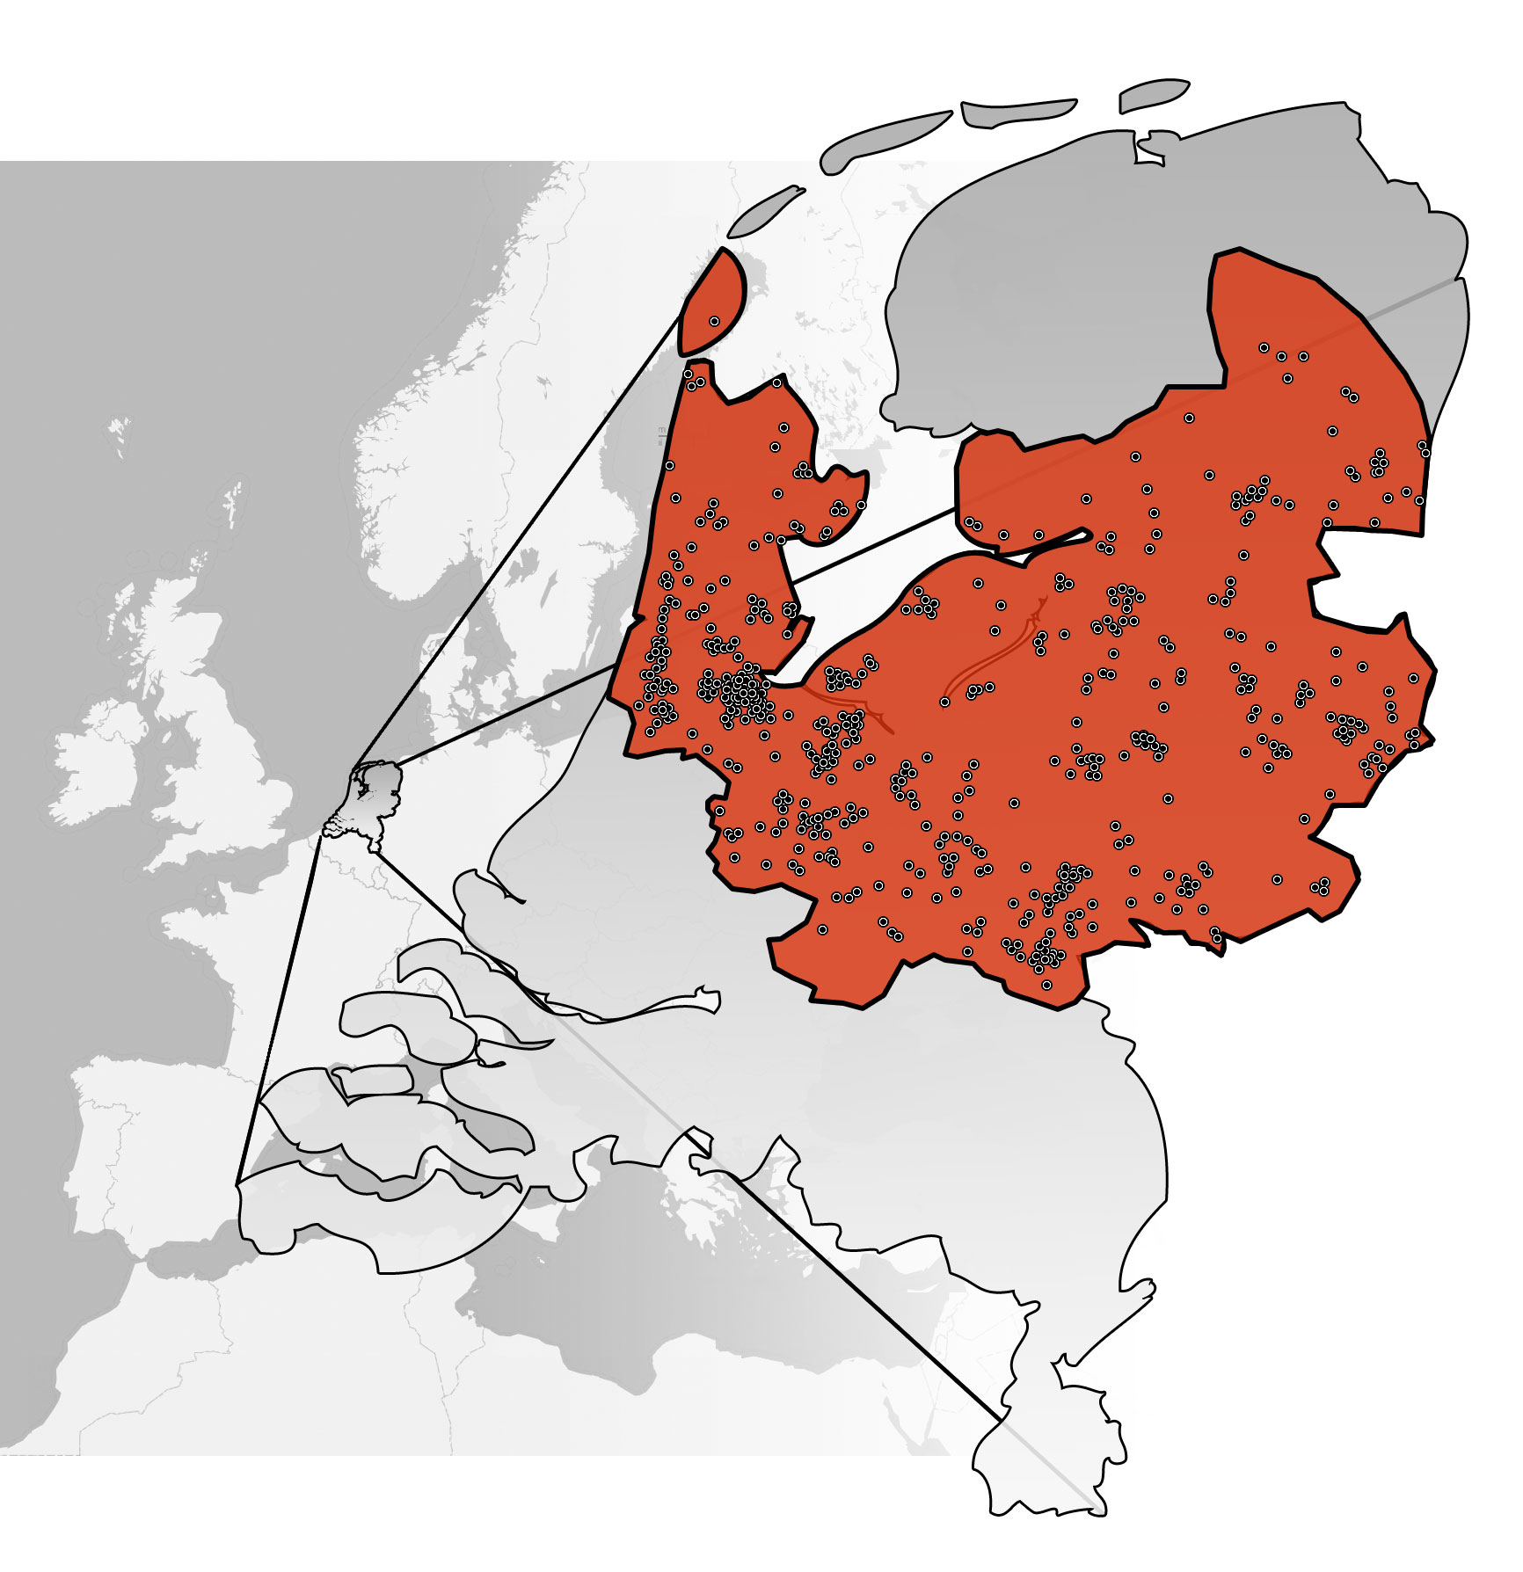
44 hospitals
Pathology registry
Endoscopy reports (ERC)
Hospital billing system
Personal registry
3020 cases
695 PSC patients
590 PSC patients resident in study area
Study population: 7,758,980
Study population: 7,758,980

Slide 8
Results
Incidence
Prevalence
Point prevalence: 6.0 per 100,000 inhabitants
Mean incidence: 0.5 per 100,000 inhabitants
Boonstra et al Hepatology 2013; 58: 2045

Slide 9
Transplant-free survival PSC
Estimated median transplant-free survival population-based PSC cohort: 21.2 yrs
Boonstra et al Hepatology 2013; 58: 2045

Slide 11
450 PSC patients liver transplant centres
590 PSC patients resident in study area
Liver transplant centre
Study population: 7,758,980

Slide 12
Transplant-free survival PSC
Estimated median transplant-free survival population-based PSC cohort: 21.2 yrs
Estimated median transplant-free survival transplantation centers PSC cohort: 12.8 yrs
Boonstra et al Hepatology 2013; 58: 2045

Slide 13
malignancies in PSC
series of 604 Swedish PSC patients
1970-1998
FU 5.7 years
mortality 28%
cause of death cancer in 44% ➔ 12% < 6 years
series of 590 Dutch PSC patients
1980-2012
FU 7.7 years
mortality 16%
cause of death cancer in 44% ➔ 7.2% < 7 years
Bergquist et al. J Hepatol 2002; 36: 321
Boonstra et al. Hepatology 2013; 58: 2045
Notes:
Epi PSC cohort: 7% CCA, 3% CRC during FU

Slide 14
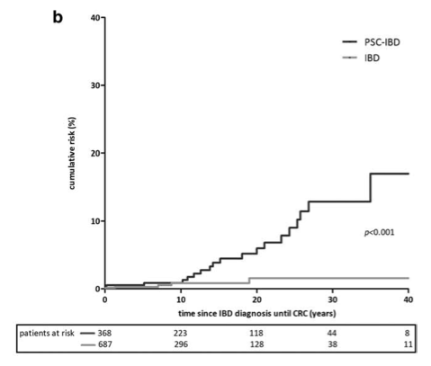
Colorectal carcinoma risk in PSC
Boonstra et al. Hepatology 2013; 58: 2045
Notes:
cumulative risk of developing CRC for PSC/IBD patients at 10, 20, and 30 years was 1%, 6%, and 13% resp.

Slide 15
Colorectal carcinoma risk
for PSC/UC risk 10x increased compared to UC controls
age at CRC much younger: median age 39 vs 59 (p=0.019)
Boonstra et al. Hepatology 2013; 58: 2045

Slide 16
RR of CRC in PSC/UC vs UC
Jess et al. Gastroenterology 2012; 143: 375
Notes:
Tine Jess: population-based cohort of 47,374 Danish IBD patients over 30 years of FU

Slide 17
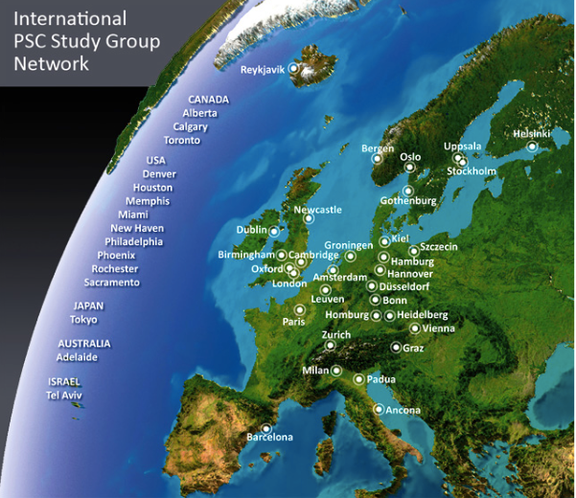
CRC risk in UC vs Crohn
IPSCSG cohort
7119 PSC patients
37 centers in 17 countries
risk of CRC increased in patients with UC (HR=2.12)
Weismueller et al. AASLD 2015

Slide 18
PSC-IBD surveillance
Full colonoscopy at PSC diagnosis and (bi)annual surveillance in PSC-IBD patients
No IBD at PSC diagnosis: repeat colonoscopy after 5 years
EASL guidelines. Hepatology 2009
AASLD guidelines. Hepatology 2010
Notes:
#2253349

Slide 19
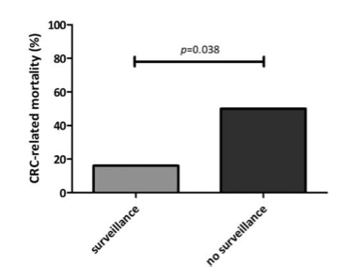
Surveillance for CRC
Boonstra et al. Hepatology 2013; 58: 2045
Notes:
16% of surveilled patients died of their CRC versus 50% in non-surveilled patients

Slide 20
Conclusions
Lower population-based incidence and prevalence rates PSC than previously reported.
Incidence and prevalence rates increase over time.
Longer estimated median survival time until liver transplantation or PSC-related death compared with previous studies from tertiary referral centres.
10x increased RR for CRC in PSC/UC warranting surveillance from diagnosis
Boonstra et al. Hepatology 2013; 58: 2045

Slide 21
future of natural history studies
purposes:
observational research into:
efficacy of medication on prognosis and symptoms
risk factors for disease behaviour
HRQoL
biomarker development
virtual placebo group for phase IV clinical trials
inception cohorts for recruitment into clinical studies
guideline implementation

Slide 22
next level Dutch PSC registry
patient reported outcome
local physician
pharmacy data wharehouse

Slide 23
thank you

