Slide 1
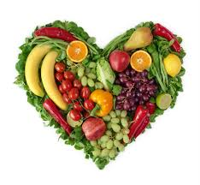
Nutrition and PSC
Anne Marie Rivard
Registered Dietitian
Yale-New Haven Hospital
June 25th, 2016

Slide 2

Nutrition’s Role in PSC
Much variable information available
“…there is no specific PSC diet…”
Varies tremendously based on stage, comorbidities
How to find out what to eat?
Notes:
Much variable information available
“…there is no specific PSC diet…” on PSC partners website
Varies tremendously based on stage of liver disease, comorbidities (transplant, weight, IBD etc)
Try to touch on common issues and present an overview of nutrition's role
Best to meet with an RD one-on-one to create a specialized plan

Slide 3
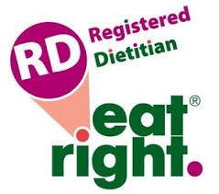
Obtaining Credible Information
Evaluating internet resources
  .org, .edu, .gov
  Cost? Advertisements?
  Literature references?
A registered dietitian (RD)? A nutritionist?
  http://www.eatright.org/find-an-expert
Notes:
Where to go to obtain credible nutrition information?
Today, many turn first to the web
May find good information, but just as easily can find information that is not credible
What is the source of the website? Is it free and accessible to all? Are there advertisements?
Patient forums are helpful but what works for one individual may not work for you
The challenging thing with PSC is that there are so many different symptoms and stages of the disease, all of which change what foods are recommended
So where to turn?
Registered dietitians
Accredited by the Academy of Nutrition and Dietitians.
They have a nutrition degree, have completed a supervised clinical internship and have passed a national exam.
They also must maintain their registration through continuing education credits every year, ensuring their knowledge is up to date.
Nutritionists are not accredited by any national organizations and do not have to maintain any continuing education.
A registered dietitian can help you plan a diet specific to your nutritional needs.

Slide 4

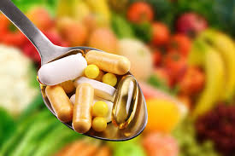
Nutritional Challenges
Maintaining optimal weight and nutritional adequacy
Malnutrition
  Cholestasis
  Bone health
  IBD
Hyperlipidemia
Herbal supplements
Notes:
PSC is a disease which presents many nutrition-specific challenges. We will touch on them today in an overview and then I encourage you to set up a one-on-one meeting with an RD to discuss specific nutritional concerns you may have.

Slide 5
Nutritional Challenges
Maintaining optimal weight and nutritional adequacy
Malnutrition
  Cholestasis
  Bone health
  IBD
Hyperlipidemia
Herbal supplements
Notes:
We’ll start with the importance of maintaining a healthy weight and diet overall

Slide 6
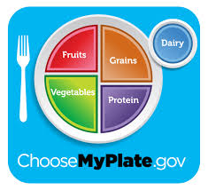
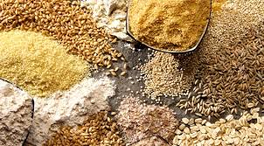

Overall Health and Wellness
Notes:
When thinking about diet for PSC, we must not forget the basic nutrition principles that apply to all and should form the foundation of our meal planning
Choosemyplate.gov is an excellent resource that can be customized- move away from food pyramid to more practical meal planning graphics
Half of your plate should be fruits and vegetables
Most adults need 1 ½ to 2 cups of fruit per day and 2 to 2 ½ cups of veggies per day
Many benefits for heart health, digestive health, lower cancer risk etc
Eat whole or cut up fruit rather than drinking juice to get the most fiber
Choose frozen fruits vegetables without added sauces
Buy canned vegetables labeled “no salt added” or canned fruits in 100% juice (not syrup)
Buy fresh fruit and vegetables in season to save money and get the best flavor
Vary your fruits and veggies- different colors convey different health benefits
¼ of your plate should be grain based
Whole grains help toward adequate fiber intake (25-30 grams/day)
Minimal sugar intake– convert label sugar from grams to teaspoons by dividing by 4– recommended to have no more than 6 teaspoons added sugar per day for women or 9 teaspoons for men

Slide 7
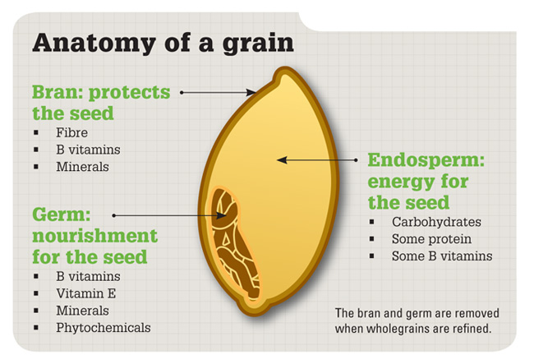
What is a whole grain?
Whole Wheat
Brown Rice
Oatmeal
Bulgur
Popcorn
Rye
Barley
Amaranth
Millet
Quinoa
Sorghum
Triticale
    Beware
    - Multigrain, stone ground, 100% wheat, cracked wheat, seven-grain, bran might ≠ Whole Grain or might ≠ Healthy
Notes:
Definition by the Whole Grain Council:
“..Contain all the essential parts and naturally-occurring nutrients of the entire grain seed”
“If the grain has been processed, the product should deliver approximately the same rich balance of nutrients that are found in the original grain seed.”
Whole Grains have more Fiber, Vitamins, Minerals, Antioxidants & phytochemicals
What counts as a whole grain? Classically, we think of brown rice, whole wheat bread and pasta
Many other unique and ancient grains such as barley, amaranth, millet, quinoa and rye
Trial and error for tolerance if you have GI associated side effects from PSC
Beware- advertisers are trying to sell the product so don’t believe the words on the front- might not mean whole grain. Also, whole grain does not necessarily mean heatlhy. Froot Loops is whole grain corn but 12 grams sugar (3 teaspoons) per serving with artifical colors, preservatives etc

Slide 8
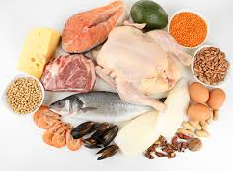
Overall Health and Wellness
Notes:
¼ of your plate should be protein-rich foods
Fish, eggs, turkey, chicken, lean beef and lean pork are good sources of protein
Try more non-meat based proteins such as eggs, beans and legumes, nuts and peanut butter, soy products. Quinoa and amaranth are complete proteins. Otherwise, need to eat a variety of vegetarian sources to get all amino acid building blocks
Evenly spread out protein throughout the day as opposed to traditional carb based breakfast, small lunch and protein rich dinner- may help with lean muscle building when spread out more evenly
1 serving of dairy
Milk, cheese, yogurt
Debate about fat content of milk- some research now showing that full fat dairy does not lead to any more weight gain or heart disease as comparted to skim milk. Research is ongoing. To our best knowledge, the lowest fat choices are still the most appropriate though a moderate amount of higher fat dairy is reasonable in an overall balanced diet.
The other important part of an overall healthy diet is one that we do not see on our plate- physical activity- aim for 30 minutes of brisk walking or other activity, 5 days per week– to be discussed next!

Slide 9
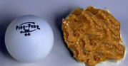
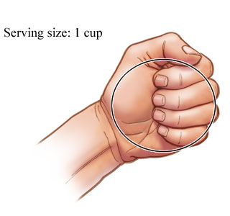


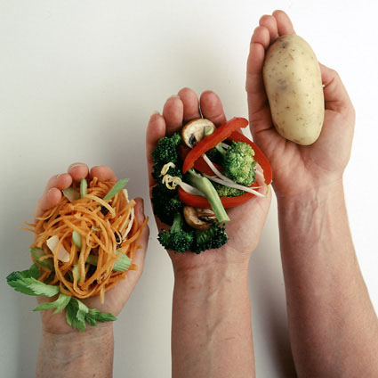


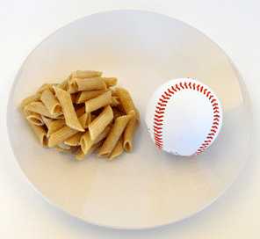

Portion Size
Notes:
No matter how healthy a food, always keep in mind portion size
Great visuals online

Slide 10
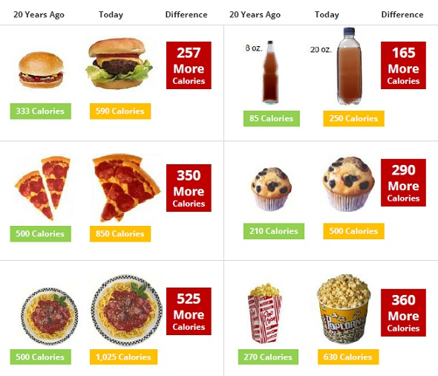
Notes:
Portion distortion- larger portions have become our new norm

Slide 11
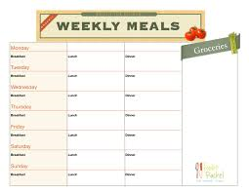
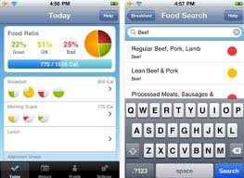

Overall Health and Wellness
Technology
  Activity/fitness trackers
  Meal tracking apps
Pre-Planning
Notes:
Much technology today to help us
If you have a sense of your basic nutrition goals, can use many online tools to track your intake
There are many online and app based food and activity trackers that are popular as well as personalized activity/food trackers that you wear such as FitBit
Can be done on a non-technical level with pre-planning of intake

Slide 12
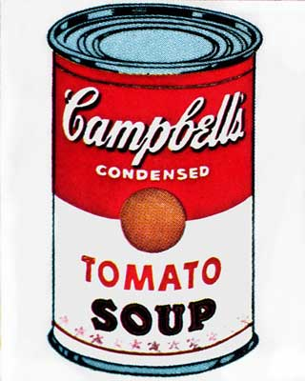
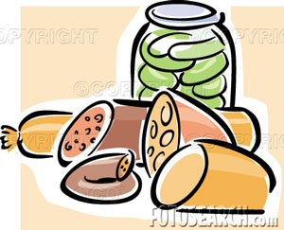
Sodium
Cut out the salt shaker
The more processed a food is, likely the more sodium it has- fresh is best. Avoid:
  Canned beans, canned vegetables, canned soup
  Frozen dinners
  Salad dressings, sauces, marinades
  Condiments (ketchup, pickles, relish)
  Salty snacks
  Deli meats, cheeses
  Cured meats (bacon, ham)
Notes:
Dietary Guidelines recommend less than 2300 mg sodium per day (1 teaspoon) for all adults
Help with blood pressure and decreased processed foods which often are not the most nutrient dense
This restriction may tighten if liver disease progresses- recommendation for cirrhosis is closer to 1500-2000 mg per day, especially if you have trouble with fluid retention
Cut out added salt
Be careful with packaged and processed foods
Use more herbs and spices for flavoring
Be careful with label reading to ensure you know what portion size you are consuming

Slide 13



Benefits of Planning Ahead
Time! Investing the time upfront will save you hours every week with less time at the grocery store and cooking
Money! Preparing a list will minimize waste and impulse buys while taking advantage of sales and coupons
Health! Having a plan guides you towards more healthful eating
Notes:
Planning ahead saves you
Time! Investing the time upfront will save you hours every week with less time at the grocery store and cooking
Money! Preparing a list will minimize waste and impulse buys while taking advantage of sales and coupons
Health! Having a plan guides you towards more healthful eating

Slide 14

Stocking the Kitchen: Food Essentials
Keep versatile items on hand for ease of meal planning
  Spices- remember to beware of hidden salt in spice blends
  No salt canned tomatoes/tomato sauce
  Stock up on dry goods when on sale (brown rice, whole wheat pasta, quinoa)
  Canned fruits and frozen vegetables
  Freeze chicken, ground turkey in frequently used portions
  Eggs– hard boil some for the week
Organize your space
  Keep counters clean
  Have multiple tools that are used often
  (measuring cups, spoons, spatulas)
  Store away equipment that is used infrequently
  Keep older food items in the front of the pantry

Slide 15




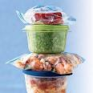
Practical Ideas For Busy People
Make large batches and freeze
  Cool completely and wrap tightly
  Freeze in appropriate portions and label/date
Be your own sous-chef
  Have a list of meals for the week
  Plan your shopping
Have portable snacks or meals
  Unsalted nuts, sunflower seeds, unsalted popcorn, peanut butter sandwich, fruit, granola bar, yogurt, Swiss cheese and unsalted crackers
  Lunch bag and reusable water bottle
Reincarnate
  Keep a list of leftovers on the fridge
  Plan when and how to use leftovers

Slide 16
Nutritional Challenges
Maintaining optimal weight and nutritional adequacy
Malnutrition
  Cholestasis
  Bone health
  IBD
Hyperlipidemia
Herbal supplements

Slide 17
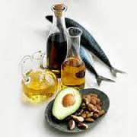

Malnutrition- cholestasis
Loss of fat-based calories
Deficiency of fat soluble vitamins
Notes:
-Experts define malnutrition as “an acute, sub-acute or chronic state of nutrition, in which varying degrees of over-nutrition or under-nutrition with or without inflammatory activity have led to a change in body composition and diminished function.”²
-Important to identify early as malnutrition can lead to other complications and worse prognosis in terms of outcomes, especially when working towards transplant
-Patients with any liver disease are at high risk for malnutrition due to the liver’s integral role in metabolism and nutrition– studies find that up to 80% of patients with liver disease that has advanced to cirrhosis also experience malnutrition
-Patients with PSC who have not yet reached cirrhosis of the liver are still at high risk for malnutrition (up to 40% of patients on one study) in that changes in the body’s absorptive capacity alter what nutrients can be utilize by the body
With damaged bile ducts, body is unable to get appropriate bile flow to the GI tract. We need bile to appropriately absorb the fats in our diet. As the cholestasis worsens and the bilirubin levels rise, the likelihood of fat malabsorption also rises
Fat contains 9 calories per grams and when not absorbed, this is a large amount of energy our body is unable to utilize- average American requires over 500 kcals per day from fat- without it, can lead to weight loss
Symptoms include fatigue, weakness, diarrhea (stools lack color, greasy, float), weight loss and can be determined through fecal fast test
Important to screen for celiac disease with these symptoms as there is an association of ~10% of patients with PSC and celiac
If excessive amounts of fat in the stool are present, indicating malabsorption, may need to restrict dietary fat intake and rely more heavily on carbohydrates and protein for increased calories. Can also use a type of fat called MCT which does not require bile salts to be absorbed- can be expensive and is not best tasting- try cooking with it or use coconut oil (~65% of fat is MCT)
Aside from the loss of calories, fat malabsorption also presents problems in that certain vitamins, namely ADEK, require fat to be absorbed- therefore, easy to become deficient in these vitamins
Important to have these levels regularly checked

Slide 18
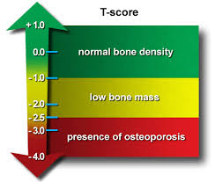
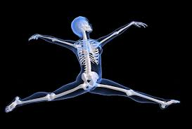
Malnutrition- bone health
Vitamin D deficiency
Calcium deficiency
Notes:
As noted previously, vitamin D is a fat soluble vitamin and deficiency may occur in PSC
Calcium deficiency is also common as the free fatty acids in the gut bind to the calcium and make it unavailable for absorption. Vitamin D deficiency further impairs calcium absorption.
These deficiencies can lead to hepatic osteodystrophy (consisting of osteoporosis and osteomalacia) which can lead to fractures, decreased quality of life and poor prognosis with end stage liver disease
Important to have bone mineral density monitored regularly and vitamin levels checked regularly and repleted as needed
Challenging to do through food alone, as body is having a hard time absorbing in its natural state- may require special vitamin supplements that put it in a form that is more easily absorbed or may require IV repletion

Slide 19
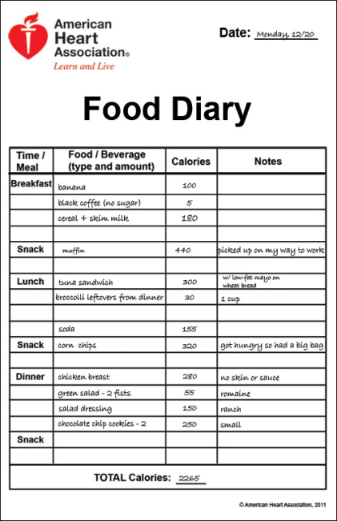
Malnutrition- IBD
Food choices become very complicated
Food journal can help identify trigger foods
Maintain regular, healthy diet during non-flare periods
Acute flares
  Evaluate fiber intake
    Cook, chop, peel, puree foods to help
    with tolerance
  Minimize sugar alcohols
  FODMAP
  Smaller, more frequent meals
  Hydrate
Notes:
Anywhere from 70-90% of patients with PSC also have IBD, most often in the form of UC
This presents many nutritional challenges and is the topic of a whole talk on its own!
Challenging and frustrating to adjust eating with diagnosis of IBD because there is no one-size-fits-all diet
No scientific evidence supporting any one diet plan for IBD
May be able to maintain a fairly regular diet the majority of the time and then may need to adjust intake during acute flares
May need to reduce insoluble fiber-- Can cook, peel, chop foods to help with tolerance
May see some gluten intolerance- food journal will help identify this
Minimize sugar alcohols
FODMAP (fermentable oligo-di-monosaccharides and polyols) are sugars found in certain carbohydrate and sugar alcohols- may have an intolerance→ gas, bloating, diarrhea, cramping (Fructose—fruits, honey, high fructose corn syrup, Lactose, Oligosaccharides are carbohydrates with a small number of simple sugars. These can be found in certain vegetables, cereals and legumes, Polyols found in sugar alcohols (sorbitol, mannitol, xylitol) and certain fruits. Challenging diet which needs oversight.
Keep a food journal to see which foods affect you and which foods are tolerated well- may be different than someone going through the same issues!
With supervision from an MD and an RD, can do an elimination diet to see what foods are triggering issues
Good idea to eat smaller more frequent meals, eat in a relaxed atmosphere, avoid trigger foods, limit food with insoluble fiber during a flare, slowly adding back in after the flare is over (i.e., seeds, nuts, beans, green leafy vegetables, fruit and wheat bran), reduce the amount of greasy or fried foods, stay hydrated

Slide 20
Nutritional Challenges
Maintaining optimal weight and nutritional adequacy
Malnutrition
  Cholestasis
  Bone health
  IBD
Hyperlipidemia
Herbal supplements

Slide 21

Hyperlipidemia
Altered lipid panels common
Unclear long term effects
May be other contributors to high cholesterol
Importance of nutrition in optimizing cholesterol profile--> TLC
  25-35% kcal Total Fat (~55-75g/day)
    <7% kcal Sat Fat (~15g/day)
    Minimal trans fat
    More unsaturated fat choices
  Increased soluble fiber intake
150 minutes moderate physical activity/week
Notes:
Common to have elevated triglycerides and total cholesterol with chronic cholestasis
Unclear what its relationship is to mortality from CVD- many studies show no increased CVD risk- may be due to high HDL levels providing a cardioprotective effect
Patients may have underlying hereditary hypercholesterolemia and in that case, may have normal or low HDL levels- in that case, may have increased CVD risk
Maintaining a healthy weight, appropriate fat intake and exercise can help
Fat is not evil- many healthy fats can actually improve our cholesterol, help with satiety and overall weight control. About 30% of calories should come from fat, but less than 7% of calories should come from saturated fat choices (high fat dairy, high fat meats)
Minimize trans fat from processed and packaged goods- on the label
Choose more olive oil, canola oil, fatty fish like salmon and mackerel as well as flax seeds
Soluble fiber from oats, bran, beans, fruits and vegetables can help lower bad cholesterol
http://www.nhlbi.nih.gov/sites/www.nhlbi.nih.gov/files/Circulation-2002-ATP-III-Final-Report-PDF-3143.pdf

Slide 22
Nutritional Challenges
Maintaining optimal weight and nutritional adequacy
Malnutrition
  Cholestasis
  Bone health
  IBD
Hyperlipidemia
Herbal supplements
Notes:
Herbal supplements
May contain copper but often not all ingredients are listed
Unsure what is truly in many of the supplements
Not regular like prescription drugs- safe until proven otherwise
Patient’s with Wilson’s are at increased risk for liver damage so would avoid supplements– all processed through liver and unclear what their effects will be

Slide 23

Herbal Supplements
Notes:
Use caution when evaluating nutritional supplements as they are not regulated like prescription drugs
They are considered safe until proven otherwise
All are processed in the liver so need to make sure they are safe
No conclusive studies that support the use of any one specific supplement for PSC
You can find many liver cleanse, liver detox formulas though caution against their use
There are many ingredients in these products, and often time specific amounts are not listed on the label- don’t really know what you are taking
Last year, New York State Attorney General found that 4 out of 5 supplements sold at Walgreens, Target, GNC and Walmart did not contain any of the herbs listed on their label
Can be a concern for those with allergies if there are fillers
Evaluate all supplements with your MD or RD before buying- make sure they don’t interact with your medications
There are independent agencies that test supplements and will certify them (USP, NSF)

Slide 24

Notes:
As dietitians, our goal is not to scare you away from eating. Rather to help you make informed choice that making eating pleasurable while maintaining your health.

