Slide 1
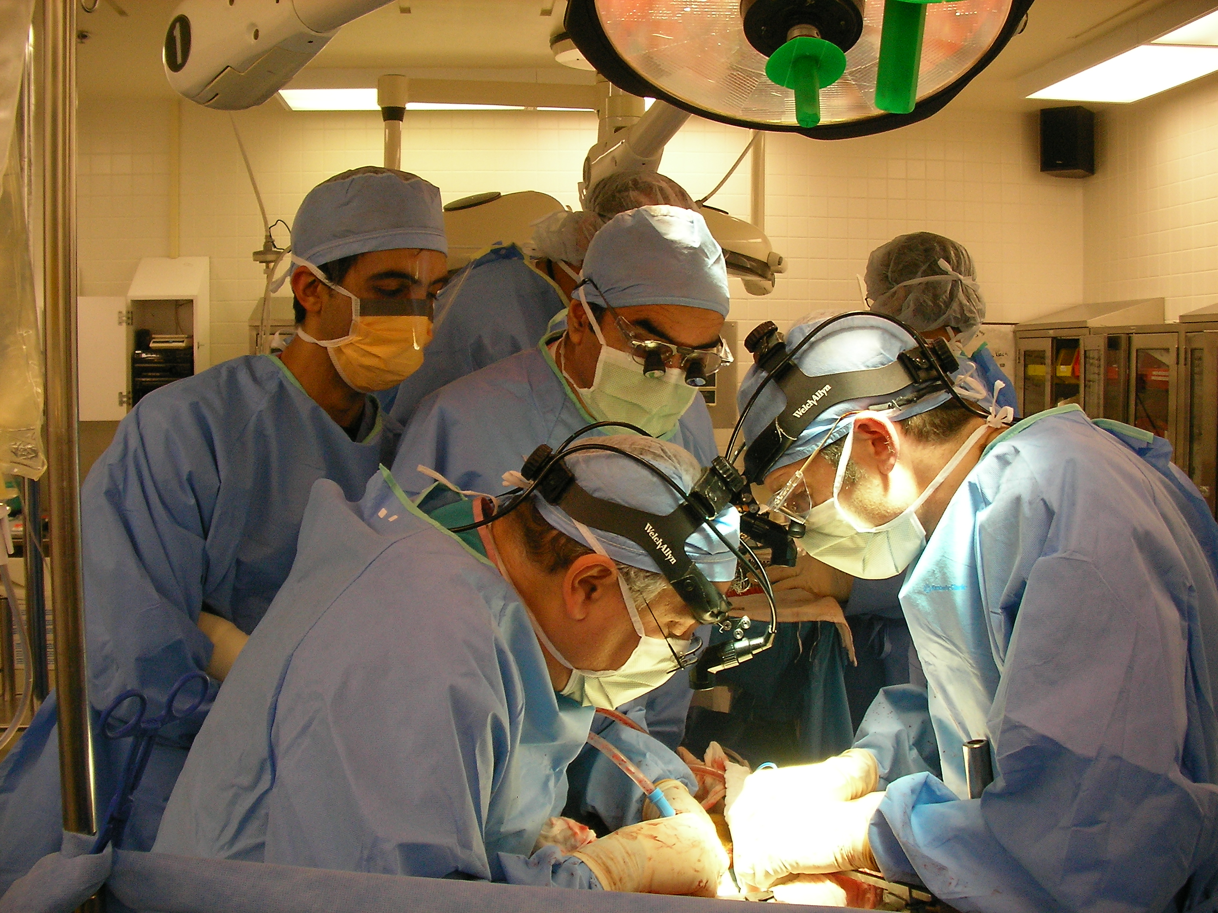
Cholangiocarinoma
In the setting of Primary Sclerosing Cholangitis

Slide 2
PSC v. Cholangiocarcinoma (CCA)
Incidence / Risk
Diagnosis
General Management
Specific Treatment Options
Surgical Removal
Liver Transplantation
Questions

Slide 3
CCA: Perspective
Ranks Second
Most common primary liver cancer
Ranks First
Frustrating: Diagnosis & Treatment
Klatskin G.*
> 50 years later: Still a Challenge
Surgery Remains Best Option
*Am J Med 1965
Notes:
Increasing incidence
Overall grim prognosis
No well established particularly effective medical treatment
Surgery available in the minority
Although Surgery clearly remains the best option when its available, even when feasible, the results can be far from satisfactory

Slide 4
PSC & CCA: Risk
Annual risk: 0.5-1.0%
Cumulative Risk Variably Reported
”Lifetime” 5-10%
30 years: about 20%
10-year 7%-9%*
PSC diagnosis to CCA: ~ 6 yrs
CCA Often Precedes Cirrhosis
*AASLD 2010

Slide 5
AASLD 2010: PSC & CCA
Duration of PSC:
May Not Be A Risk per se
About Half of Patients:
CCA Detected At Time of Diagnosis or within 1 year
Tumor May Have Led to Symptoms and Diagnosis
80% of CCA occur ≤ 1 year of PSC diagnosis
Worst Outcomes in this Group

Slide 6
Liver Tumors: Origins
Hepatocellular
Carcinoma
Liver Cells
Normal Liver
Cholangiocarcinoma
Chronic Inflammation
Bile duct Cells
Viral Disease
Toxins (alcohol)
Autoimmune Diseases

Slide 7
Bile Ducts: Inflammation to Malignancy
No Inflammation
Dysplasia
Malignancy
Dysplasia-Carcinoma Sequence

Slide 8
Anatomy: Locations
Liver
“Peripheral or
Intrahepatic”
“Hilar or
Perihilar”
Pancreas
“Distal”
Common Bile Duct
Pancreatic Duct

Slide 9
CCA: Classification
Peripheral
Resection
No Transplants
Distal
Mixed / HCC
Hilar
Notes:
Just to dispatch with terms: CCA comes in a variety of flavor: Distal we treat as we do pancreatic primarys, mixed cell types are treated more as HCC, Peripheral CCA are resected as feasible based on size location – but Hilar are the truly special and focus of today’s discussion
Periph continue to be absolute contraindication to transplantation

Slide 10
PSC: Strictures v. CCA
Dominant Strictures:
≤ 1.5 mm narrowing of Common Bile Duct
≤ 1.0 mm narrowing of hepatic ducts within 2 cm of bifurcation
CCA Can Mimic
Right Duct
Left Duct
“Bifurcation”
Common Bile Duct

Slide 11
PSC & CCA: Diagnosis
Tumor Markers: CA19-9
ERCP: Dominant Strictures (Narrowings)
MRI/MRCP: Bile Duct Strictures or Masses
Brushings: Cytology (Abnormal Cells found with ERCP)
“FISH”: Fluorescent In-Situ Hybridization
Utilizes fluorescently labeled DNA probes to examine cells for chromosomal alterations

Slide 12
Diagnostic Difficulties
Strictures v Tumor: Often Indistinguishable
Strictures: More Often Benign than Malignant
CA19-9: Often Elevated for Other Reasons
”Tumor Marker”
Not Always Helpful
Brushings: 43% sensitive, 97% Specific
False Results Common
MRI/MRCP: 89% Sensitive, 75% Specific
Endoscopic Ultrasound (EUS): Helpful
Avoid Biopsy to Maintain Transplant Candidacy!
PET Imaging: Overall Unhelpful

Slide 13
CA19-9: More Details
Most Studied Tumor Marker for CCA
Usually Elevated When Tumor is Present
CA19-9: ≥ 130 U/mL (normal 55 U/mL)
Sensitivity 79% , Specificity 98%
Often Elevated for Other Reasons:
Infection
Strictures
Some Patients: Always Negative
Lack “Lewis Antigen” (Genetic Variation)
5-10% Missing
Notes:
Sensitivity = True positive, Specificity = True negatives

Slide 14
AASLD 2010: Recommendations
Look for CCA when:
Patient Performance “Deteriorates”
Liver Studies Worsen
If CCA found and No Cirrhosis: Surgery
If CCA found with Cirrhosis: Transplantation
Following Protocols
(Not Very Helpful)

Slide 15
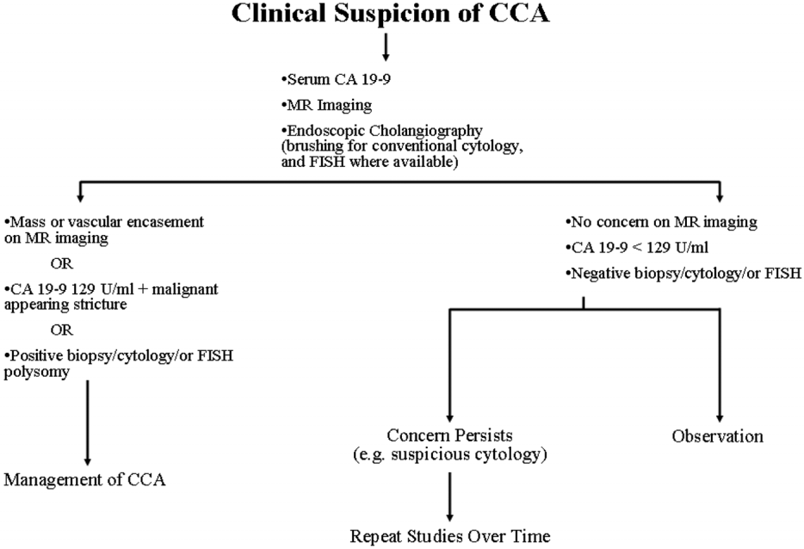
AASLD 2010:

Slide 16
PSC & CCA: Screening
Regular Laboratory Studies
Routine Imaging
MRI/MRCP Most Sensitive
Avoids Radiation Associated with CT
ERCP When Indicated
Brushings (Cytology)
FISH
PET Scans: Can Be Misleading
Remain Suspicious
3-6 Months
Annually?

Slide 17
Treatment

Slide 18
Tumor no PSC
Surgical Removal
Alone
PSC no Cirrhosis
Tumor
Normal Liver
PSC w/ Cirrhosis
No Tumor
New Liver
(Transplant)
PSC w/ Cirrhosis
and Tumor

Slide 19
Bismuth-Corlette Classification
Can it be Excised?
Also: Blumgart, AJCC, many others
Notes:
Classification is still as described by Bismuth – although there are a number existing, proposed and evolving classification and staging systems, Bismuth’s remains the most relevant to the big question: can it be removed?

Slide 20
Liver
Stomach
Roux en Y Reconstruction

Slide 21
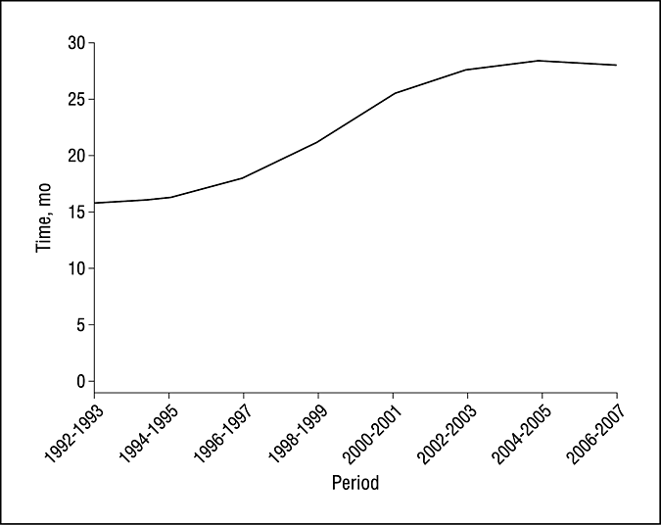
Time trend analysis of median survival after liver resection over the years
Nuzzo, G. et al. Arch Surg 2012;147:26-34.
Copyright restrictions may apply.
Notes:
Years on the bottom x axis with survival on the y axis – clearly an improvement over the years

Slide 22
Resection for CCA: Pros & Cons
PRO:
Con:
Surgery is Relatively Immediate
No Prolonged Pre-Surgery Treatments
No Immunosuppression
Can Theoretically Encourage Tumor Progression
Likely Close to Home
Versus Travel to Specialized Center
Removal of Larger Portion of Liver
Precluded by Cirrhosis
Significant Potential Complications
Often Disease Not All Removed
Tumor May be “Multi-focal”

Slide 23
Liver Transplantation

Slide 24
Liver Transplant: Diagnostic Criteria
Positive (or strongly suspicious) Intraluminal Brush or Biopsy
Radiographic Malignant-Appearing Stricture Plus:
CA 19-9 of >100 U/ml In The Absence of Infection (or)
Polysomy on FISH
A Well-Defined Mass on Cross-Sectional Imaging
HPB 2015, 17, 691–699

Slide 25
Mayo Protocol: Inclusion Criteria
Diagnosis:
CA-19.9 > 100
Mass
FISH ploidy
Tumor Radial ≤ 3 cm
Unresectable above Cystic duct
Candidate for OLT
(EUS biopsy regional nodes*)
*Dramatic Reduction of Positive Ex Lap
Rosen et al Trans Intrnl 2010

Slide 26
Mayo Protocol: Exclusion Criteria
Prior direct Tumor biopsy
Intrahepatic CCA (peripheral)
Uncontrolled infection
Prior radiation or chemotherapy
Prior resection attempts
Intra hepatic metastases
Extrahepatic disease
Rosen et al Trans Intrnl 2010

Slide 27
Mayo Clinic Protocol
External Beam (45 Gy / 30 fractions)
5-FU infusion during RT
Iridium Brachytherapy (20 Gy @ 1cm, 24 hrs)
Capecitabine (Xeloda) until transplant
Pre-Transplant Laparotomy (MELD guess)
Exploration Hilum
Regional LN biopsy
Liver Transplant (wait variable)
Notes:
Operative staging
was intended to limit transplantation to patients with localized
disease and absence of regional lymph node metastases.
Xeloda
Protocol carries possibility of significant morbidity or mortality: cholangitis, intrahepatic abscess, sepsis not infrequent issues
Significant radiation doses can make exploration difficult and can make subsequent OLT challenging – long-term post OLT vascular complications are also a concern both arterial and venous – initial Mayo study the late vascular complications were >40% (which is huge compared to a normal rate of <5%)
Likely even greater concern in the circumstance of living donor OLT

Slide 28
Brachytherapy:

Slide 29
Transplantation: Outcomes
Drop-out:
30% at 12 months
5 year Overall Survival:
65-70%
Disease Recurrence:
20%
Generally Equal to Other Transplant Indications
Gores et al Dig Dis 2013;31:126-129

Slide 30
Versus
?

Slide 31
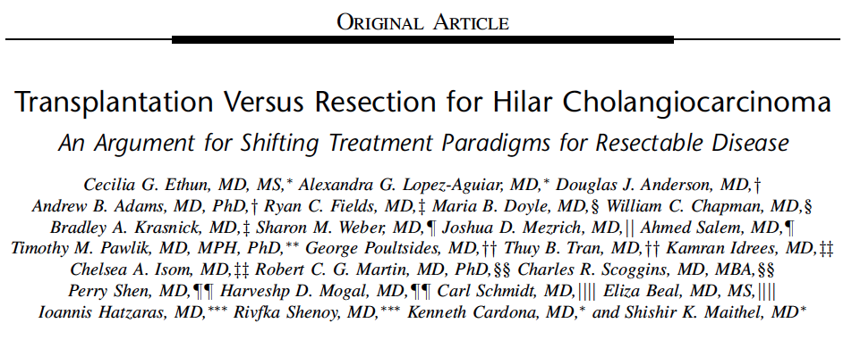
Resection v. Transplant?
(Ann Surg 2018;267:797–805)

Slide 32
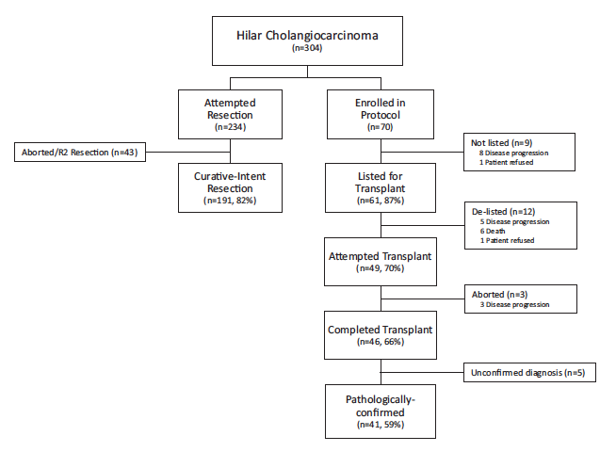
Resection v Transplant
10 Centers
304 Patients
234 Intended Resection
70 Intended Transplant
Ann Surg 2018;267:797–805

Slide 33
Resection v. Transplant: Outcomes
3 years:
72% Transplant
33% Resection
5 years:
64% Transplant
18% Resection
Intention-to-treat: Transplant Outcomes Superior
Adjust Tumor Size
Adjust Lymph Nodes
Retrospective Trial
Ann Surg 2018;267:797–805

Slide 34
OLT for Intrahepatic CCA:?
5 year Survival: 100%
Role for Transplantation Still Evolving
HepatoBiliary Surg Nutr 2017;6(5):332-334

Slide 35
Why Not “Pre-emptive” Transplant?
Lifetime Risk of CCA in PSC Patients Is Elevated
However:
Low Annual Incidence of CCA in Any One Individual
Risks of Otherwise Un-necessary Major Surgery
Overall Shortage of Organs Available
What About Living Donor Transplant?
Possible
Significant Risk to Donor & Recipient v. Necessity
Select Circumstances: Reasonable?

Slide 36
Summary:
Remain Suspicious
Remain Vigilant
Keep Options Available
No Transperitoneal Biopsies
Seek Transplant Center Advice Early
Not all have CCA protocols
Second Opinions: Never a Bad Idea
Be Smart!

Slide 37
End

Slide 38
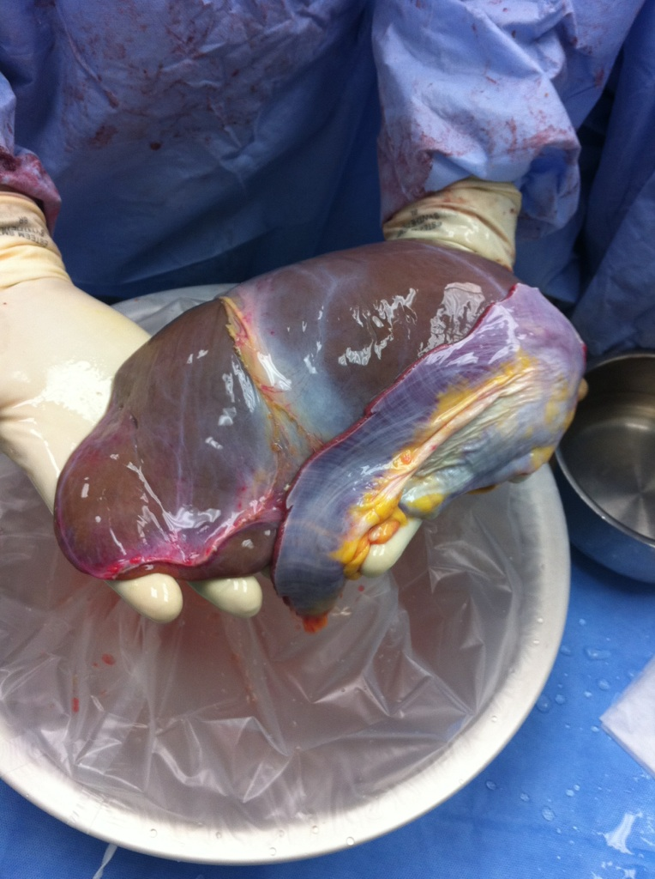
Shortage
6/22/18
Tumor Board
Notes:
38

Slide 39
Dysplasia v Malignancy
In conclusion, there is currently no reliable method
to differentiate LGD from HGD prior to LT. CA19-9
rises with CCA but not in biliary dysplasia. Repeated
suspicious BC, which suggests dysplasia and a high
risk for future CCA, may be an indication for LT.
Boyd et all W J Gastroeterol 2017

Slide 40
Guidelines for Screening:
AASLD (2010)
”suspicious clinical / biochemical deterioration”
CA19-9 > 129 U/ml
MRI/MRCP, ERCP
Cytology (brushings)
FISH polysomy
Mayo Clinic
Annual screening
MRI/MRCP
CA19-9
ERCP (dominant strictues)

Slide 41
Liver Transplant: Exclusion Criteria
Patients with metastases, prior abdominal radiotherapy pre- cluding additional therapy, a previous attempt at surgical resection with violation of the tumour plane, or any medical condition precluding transplantation
a mass with a clear radial diameter of >3 cm is generally excluded (a longitudinal extension along the duct for >3 cm does not imply exclusion)
(Vascular encasement and stricture/mass extension along the duct is not a contraindication)

Slide 42
Liver Transplantation
When combined with a pre-transplant reg- imen of chemotherapy and radiation, 5-year survival from the start of therapy ranges from 55% to 65% among patients with cholangiocarcinoma arising in a background of PSC.5
Patients with PSC / CCA fare better than those de novo CCA
Liver transplantation following a standardized protocol including external beam and transluminal radiation, as well as systemic chemotherapy, is the standard of care for both unresectable hilar CC, as well as hilar CC arising in the set- ting of PSC

Slide 43
Liver Transplantation:
Neoadjuvant therapy includes external beam radiotherapy (EBRT) administered to a total dose of 4500 cGy (in 30 frac- tions of 150 cGy twice daily for 3 weeks)
continuous infusion of 5-fluorouracil (5-FU) given for the duration of EBRT.
endoluminal brachytherapy boost is then delivered through transcatheter iridium-192 seeds
oral capecitabine for 2 weeks in every 3-week period until transplantation
Operative exploration with routine biopsy of lymph nodes plus any suspicious lesion is performed near the anticipated time of transplantation

Slide 44
CCA & Transplant: Issues
Cost & Resources
Ethics of Organ Allocation versus outcomes
Co-morbidities (age +)
Significant Waiting Times
Immunosuppression
Converting Slowing Progressive Disease
Limited Resource: Organs for Transplant
Outcomes: High Standards
Notes:
On the other hand – there is the impact of the requisite immunosuppression
The considerable magnitude of a transplant
The utilization of scarce resources versus outcomes
The costs
the delays – waiting for organs
The dilemmas of organ allocation!

