Slide 1
PSC Partners Seeking a Cure
12th Annual Conference for PSC Patients & Caregivers
New Haven, CT
June 24, 2016
Coping with the Stress of PSC:
Maintaining Resilience
For Caregivers
Dwain C. Fehon, Psy.D.
Assistant Professor, Psychiatry
Yale School of Medicine
Dwain.fehon@yale.edu

Slide 2
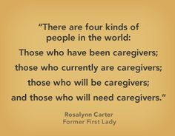
You Are Not Alone
More than 65 million family caregivers in the US
Family caregivers are growing and important segment of our society.
Invaluable to the medical system and to society
Many are not supported in their role
Caring for a family member can impose many emotional, physical, social, financial and spiritual challenges

Slide 3

Living with PSC
Can feel like an emotional rollercoaster
May effect how you think about your yourself, your life, and your relationships
May challenge your ability to cope

Slide 4
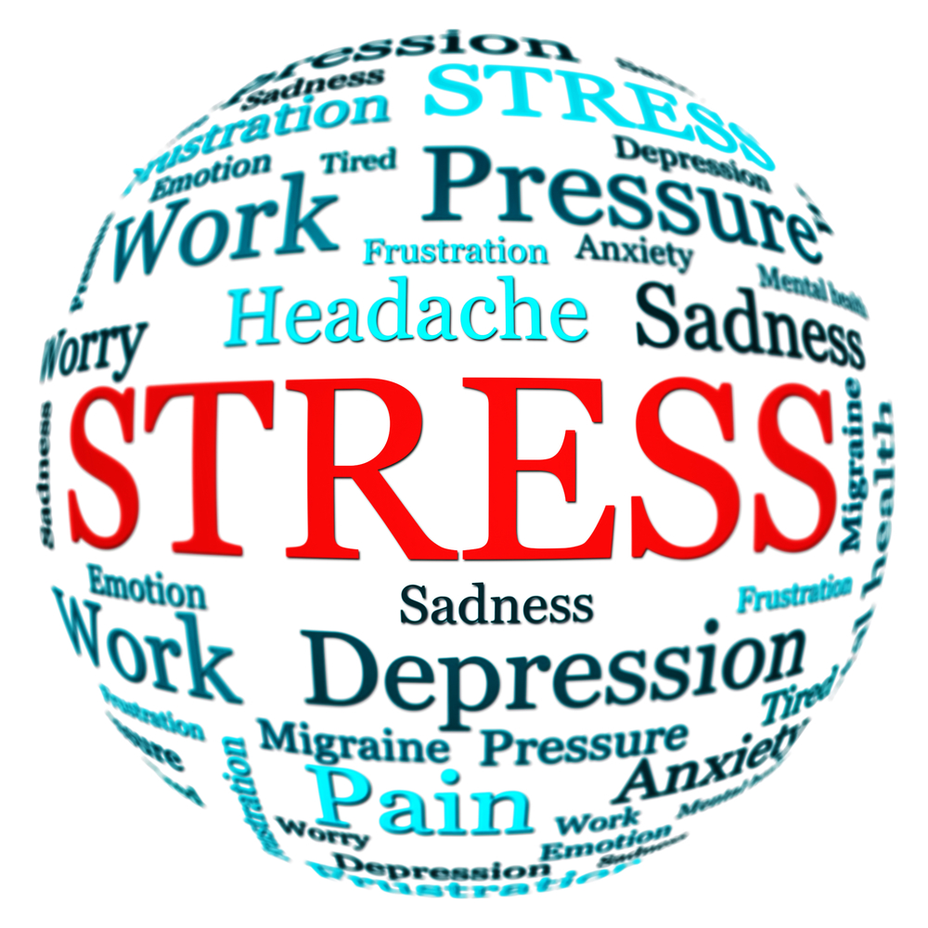
Stress
    Stress is a state of physical, mental or emotional tension
    “Fight or flight”

Slide 5
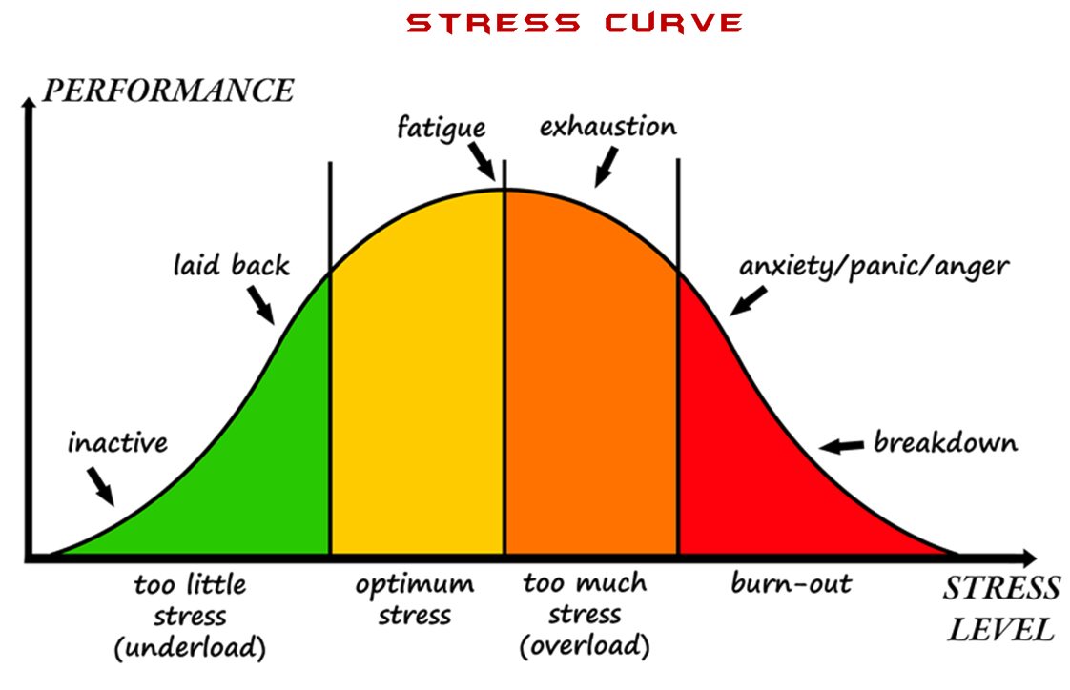
Stress and Performance
    Mild stress can be motivating, but chronic high stress can have negative physical and mental health consequences.

Slide 6
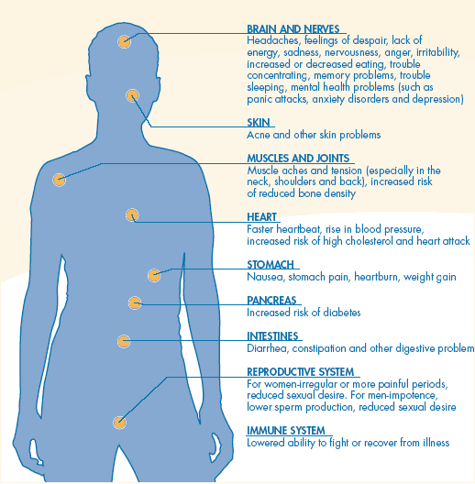
Chronic Stress and Health
    Numerous physical systems can be effected by chronic stress

Slide 7
Common Challenges for Caregivers
Dealing with disappointment and frustration
Coping with uncertainty
Managing changing roles
Managing job and finances
Maintaining your own health and wellbeing
Having patience, faith and courage

Slide 8
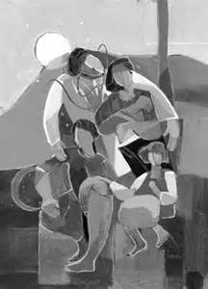
Causes of Caregiver Fatigue/Burnout
Role confusion
Unrealistic expectations
Lack of control
Unreasonable demands
Isolation

Slide 9
Signs of Caregiver Burnout
You have much less energy than you once had
It seems like you catch every cold or flu that’s going around
You’re constantly exhausted, even after sleeping or taking a break
You neglect your own needs, either because you’re too busy or you don’t care
Your life revolves around caregiving, but it gives you little satisfaction
You have trouble relaxing, even when help is available
You’re increasingly impatient and irritable with the person you’re caring for
You feel helpless and hopeless

Slide 10
Depression
A medical illness caused by biochemical alterations in the brain that can be brought on by medical illness and emotional stress
Depressed (or irritable) mood
Loss of interest or pleasure in nearly all activities
Accompanied by changes in sleep, appetite, concentration, energy, a sense of hopelessness, guilt or thoughts of suicide
Impairs usual functioning

Slide 11
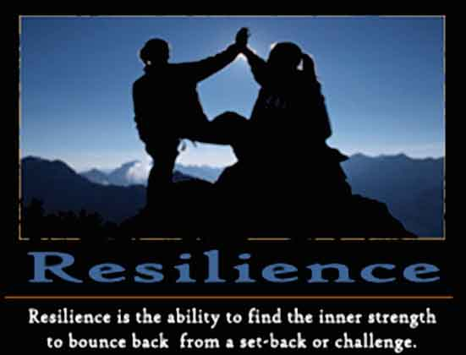
Resilience
“The process of adapting well in the face of adversity…‘bouncing back’ from difficult experiences”
(American Psychological Association)
“The ability to become strong, healthy, or successful again after something bad happens”
(Merriam Webster Dictionary)

Slide 12
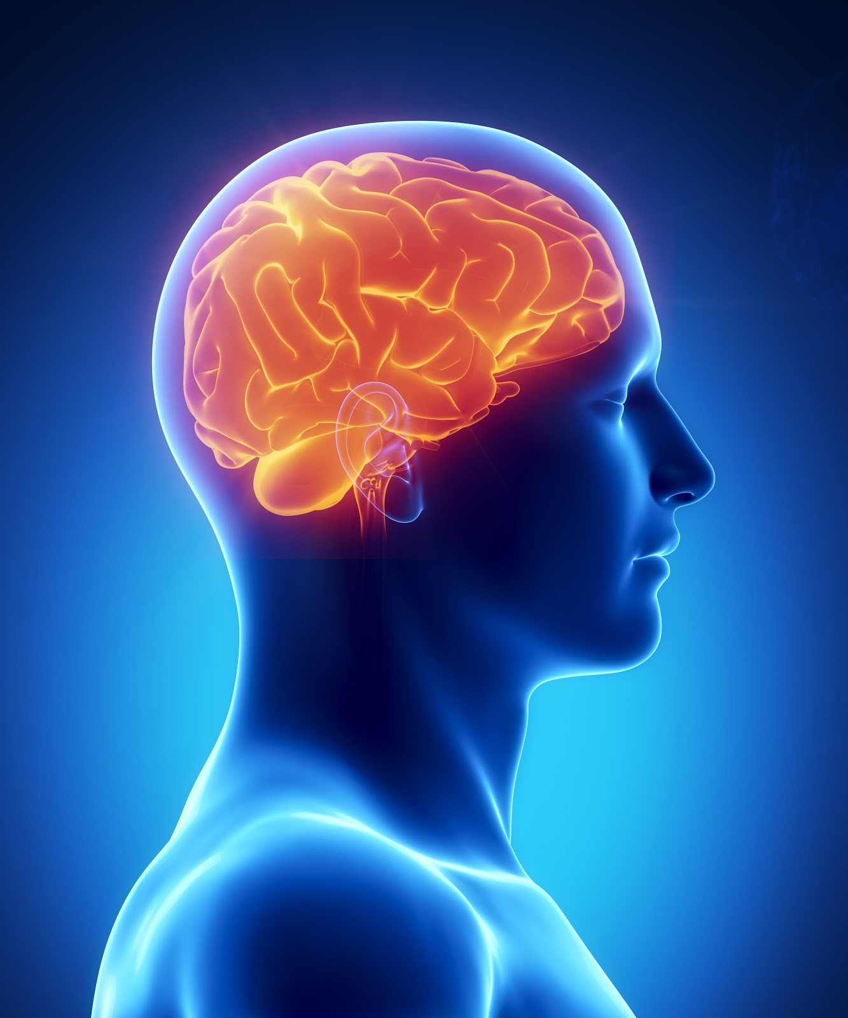
The Science of Resilience
Concerned with understanding the neurobiology of stress and what helps people remain resilient and healthy in the face of extreme stress
Can changing how we think about stress, change how the body responds to stress?
The harmful effects of stress are not inevitable

Slide 13

Positive Attitude (Optimism)
Hope and confidence
A belief in one’s self
The capacity to look on the favorable side of events
Expecting the best outcome from any given situation

Slide 14

Tenacity
Persistence
Resolve
Refusal to give up
Grit
Determination

Slide 15
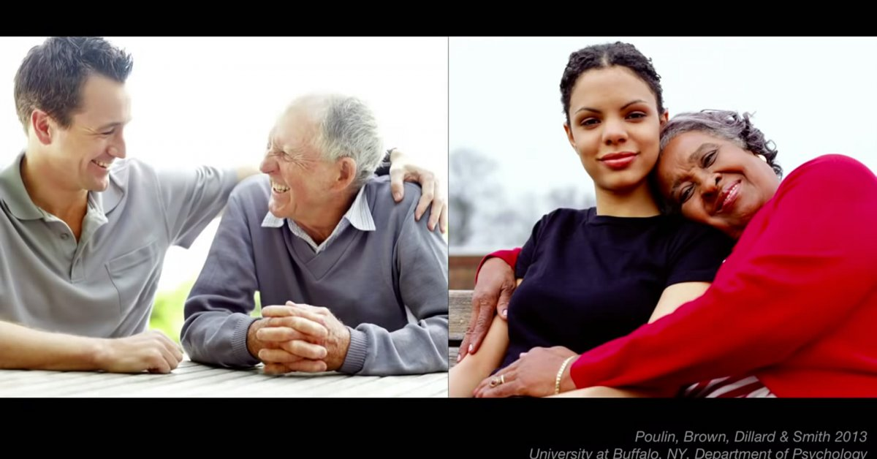
Social Connection
Participating in and enjoying social relationships.

Slide 16

Faith and Spirituality
Traditional or non-traditional faith and spirituality
A belief in something greater than one self
A connection to a higher power

Slide 17
Maintaining (Building) Resilience
A Best Practice Approach
1. Healthy lifestyle as a foundation for managing stress and promoting good physical and mental health
2. Active medical care and symptom management to minimize any distressing physical symptoms
3. Healthy habits of the mind to facilitate coping and resilience

Slide 18
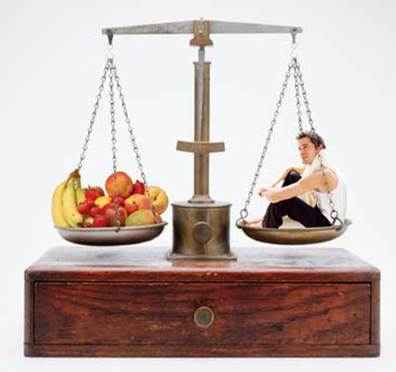
Healthy Lifestyle
The Foundation for Managing Stress and Tension
Healthy diet & nutrition
Exercise regularly
Get adequate sleep
Time with family and friends
Accept help from others

Slide 19
Active Medical Management
Regular medical check-ups and dental care
Preventative medicine
Optimize symptom management
Medication adherence for existing illnesses
  Heart conditions Diabetes
  Blood pressure Thyroid
  Cholesterol Pain

Slide 20
Habits of the Mind
The basic principle: Thoughts, feelings, and behaviors are all connected.
How we think and how we act, shape how we feel.
Thoughts
Behaviors
Feelings

Slide 21
Effective Coping
Identify the controllable and uncontrollable aspects of a problem
Is the stressor within your Is the stressor outside your control? control?
Problem-Focused Coping Emotion-Focused Coping
Problem solving Rethinking the situation
Gathering information Reframing thoughts
Decision making Acceptance strategies
Resolving conflicts Seeking emotional support
Setting goals Exercise
Asking for help Meditation

Slide 22

Mindfulness
To help accept the uncertainty of the future
Mindfulness is “being in the present moment”
Observe using your senses
Be non-judgmental
Focus on one thing at a time
Describe
Participate fully

Slide 23
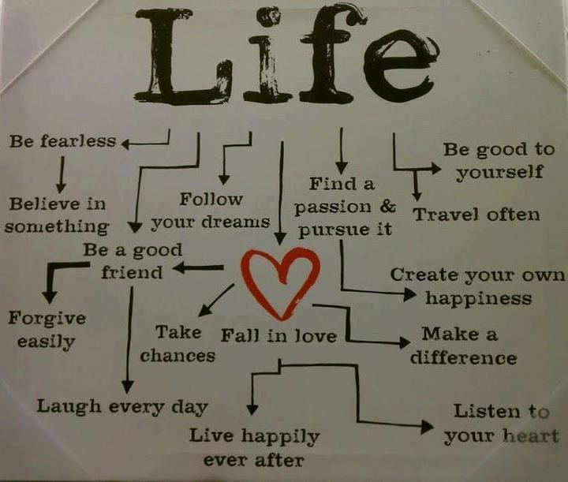
Purpose & Meaning
What is the purpose of my life?
What gives meaning to my life?
What is most important to me?
What are my deepest values and beliefs?

Slide 24
Strategies to Manage Stress and
Build Resilience
1. Maintain good nutrition
2. Exercise regularly
3. Rest when you need to
4. Be active with your medical care
5. Optimize medical/symptom management
6. Make time with family and friends
7. Accept help from others
8. Actively problem-solve things within your control
9. Learn to accept things outside of your control
10. Stay connected to things that bring you meaning and joy

Slide 25
Discussion Questions
How has PSC changed your life?
What are your hopes?
What are your worries?
What gives you strength?

Slide 26
Thank You

