Slide 1
The case FOR UDCA in PSC
Aparna Goel, MD
Stanford University School of Medicine
Liver Transplant Program
June 23, 2018

Slide 2

If you are a PSCer:
Raise your hand if you have ever been prescribed UDCA?

Slide 3
So what is there to debate about?
Studies evaluating UDCA have yielded varying results
Conflicting recommendations from national societal guidelines
  AASLD – recommends against UDCA
  EASL – recommends use in some patients
  ACG – acknowledges common use of UDCA

Slide 4
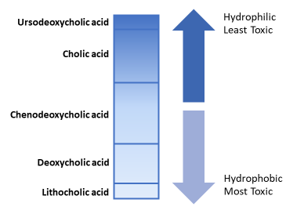
What is UDCA?
Ursodeoxycholic acid
  AKA: Ursodiol, Urso Forte, UDCA, URSO-250, Actigall, Ursofalk
  Originates from bear bile
  Initially used to dissolve cholesterol gallstones
  Changes the composition of bile so that it is LESS toxic to liver cells
Lindor KD, et al. Am J Gastroenterol. 1998 Sep;93(9):1498-504.
Notes:
Treatment with ursodiol can increase composition the percentage of UDCA in bile acids by 40% (seen in PBC patients)

Slide 5
The UDCA saga in PSC
1990-1995
10-15 mg/kg/day
Small pilot trials^{1,2,3,4}
Decreased alkaline phosphatase (AP) and improvement in liver biopsy
Chazouilleres, O., et al. J Hepatol. 1990; 11: 120123
OBrien, C.B., et al. Hepatology. 1991; 14: 838847
Beuers, U., et al. Hepatology. 1992; 16: 707714
Stiehl, A. Scand J Gastroenterol Suppl. 1994; 204: 5961
Notes:
Once ursodiol showed efficacy in the management of PBC, there was interest in studying the medication for the other cholestatic liver disease, PSC.
Small pilot trials of UDCA in the early 1990's demonstrated biochemical and in some cases histological improvement in PSC patients using doses of 10–15 mg/kg/day
15 patients; decrease in fatigue/ pruritus, decrease in AP, GGT and ALT levels
12 patients; decrease in cholesterol, AP, ALT, bilirubin after 2 years of treatment and improved fatigue, pruritus and diarrhea.
14 patients; decreased AP, ALT, bilirubin after 1 year
43 patients; decreased incidence of LT in UDCA-treated group

Slide 6
The UDCA saga in PSC
1990-1995
1997
10-15 mg/kg/day
Small pilot trials
Decreased alkaline phosphatase (AP) and improvement in liver biopsy
13-15 mg/kg/day
105 patients for 2 years¹
Improved liver enzymes
No difference in symptoms, death, liver transplantation, progression to cirrhosis (histology) or complications (varices, ascites, encephalopathy)
Lindor KD, et al. N Engl J Med. 1997 Mar 6;336(10):691-5.
Notes:
Landmark trial by Dr. Lindor in 1997:
Enrolled 105 patients in a double blind, placebo-controlled RCT
Ursodiol was associated with improvement in AP, AST, TB and albumin
NO difference in rate of treatment failure, symptoms or histology
What about higher doses?

Slide 7
How about higher doses of UDCA?
Randomized trial of 26 patients
20mg/kg vs. placebo for 2 years
  22 patients had repeat ERCP and biopsy
Significant improvement in:
  Serum alkaline phosphatase
  Serum GGT
  Cholangiograms
  Fibrosis
Mitchell SA, et al. Gastroenterology. 2001 Oct;121(4):900-7
Notes:
These were studied next on the grounds that perhaps at higher doses of UDCA, there may be sufficient enrichment of the bile acid pool to be effective.
This group likely achieved maximal enrichment of the bile acid pool as this occurs with doses of 22–25 mg/kg per day

Slide 8
The UDCA saga in PSC
1990-1995
1997
2005
10-15 mg/kg/day
Small pilot trials
Decreased alkaline phosphatase (AP) and improvement in liver biopsy
13-15 mg/kg/day
105 patients for 2 years
Improved liver enzymes
No difference in symptoms, death, liver transplantation, progression to cirrhosis (histology) or complications (varices, ascites, encephalopathy)
17-23 mg/kg/day¹
219 patients for 5 years
**Initial study design: 346 patients needed for the study
Death or liver transplant: 7% in UDCA group vs. 11% in placebo group
Olsson R, et al. Gastroenterology 2005;129(5):1464–72
Notes:
Largest trial to date.
219 patients from Scandinavia followed for 5 years.
Unfortunately, enrollment fell far short of the 346 randomized patients required to detect a significant difference in transplant-free survival between UDCA and placebo groups
The combined end point “death or liver transplantation” occurred in 7 of 97 (7.2%) patients in the ursodeoxycholic acid group vs 11 of 101 (10.9%) patients in the placebo group (P = .368)
Compared to prior studies, biochemical improvements were lower than expected, raising concerns for compliance

Slide 9
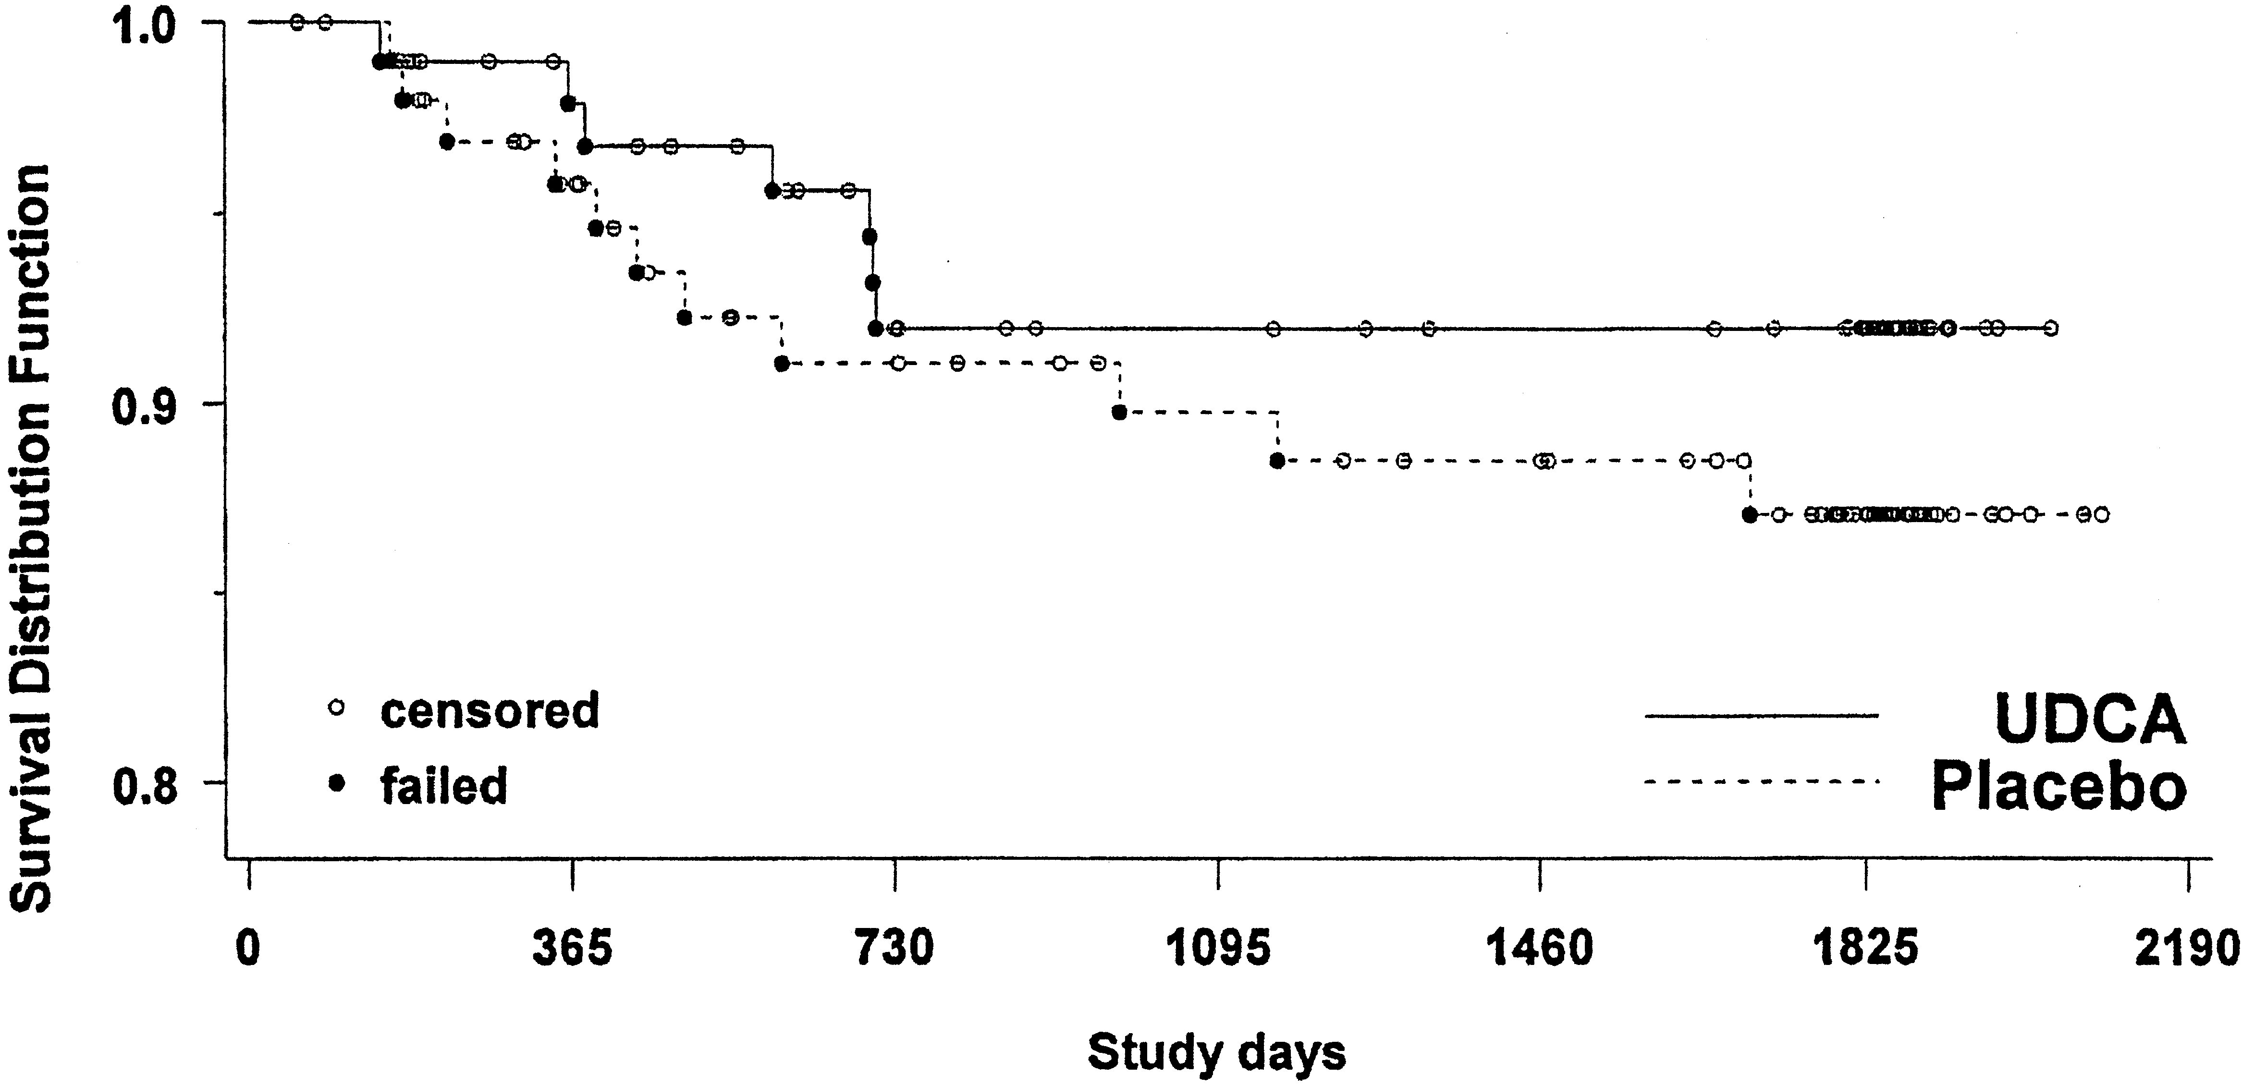
  36% improvement in death or transplant compared to placebo
Olsson R, et al. Gastroenterology 2005;129(5):1464–72
Notes:
The combined end point “death or liver transplantation” occurred in 7 of 97 (7.2%) patients in the ursodeoxycholic acid group vs 11 of 101 (10.9%) patients in the placebo group (P = .368)
If the same proportions were carried out for 346 patients:
12 of 173 patients – UDCA group
19 of 173 patients – placebo group
P-value improves to 0.25

Slide 10
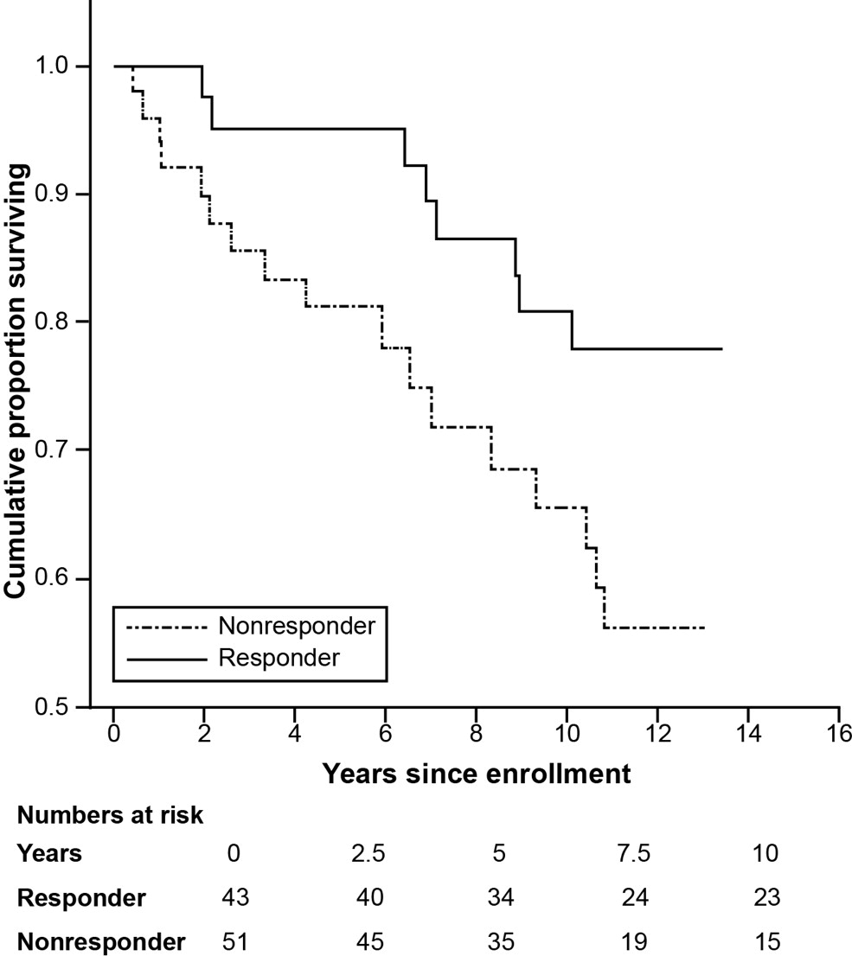
Patients that responded to UDCA with a lowering of alkaline phosphatase in this study had a better outcome after 10 years
Alkaline phosphatase reduced
Alkaline phosphatase not reduced
Lindstrom et at, Clin Gastroenterol Hepatol. 2013 Jul;11(7):841-6
Notes:
The longterm follow-up analysis of 198 patients in the 5-year trial of UDCA (n = 97 on UDCA and n = 101 on placebo) performed in 2009–2010 is particularly informative regarding the long-term safety and efficacy of UDCA at doses of 17–23 mg/kg per day
While actuarial survival did not differ between patients randomized to the UDCA or placebo arms of the trial, the cumulative probability of surviving for 10 years was significantly increased in “responders” to UDCA, defined as a reduction of ALP either to normal or by ≥40% from baseline after 1 year in the trial
Response: normal or ≥40% reduction in ALP after 1 year in the trial (P = .033)

Slide 11
The UDCA saga in PSC
1990-1995
1997
2005
2009
10-15 mg/kg/day
Small pilot trials
Decreased alkaline phosphatase (AP) and improvement in liver biopsy
13-15 mg/kg/day
105 patients for 2 years
Improved liver enzymes
No difference in symptoms, death, liver transplantation, progression to cirrhosis (histology) or complications (varices, ascites, encephalopathy)
17-23 mg/kg/day
219 patients for 5 years
*Initial study design: 346 patients needed for the study
Trend towards increased survival in the UDCA treatment group
28-30 mg/kg/day¹
150 patients for 5 years
*Study was terminated early for safety concerns
Increased risk of death, transplant, minimal listing criteria compared to placebo
Lindor KD, et al. Hepatology. 2009 Sep;50(3):808-14
Notes:
Based on similar thought process, higher doses of UDCA were subsequently studied.
the risk of a primary endpoint was 2.3 times greater for patients onUDCAthan for those on
placebo (P < 0.01) and 2.1 times greater for death, transplantation, or minimal listing criteria

Slide 12
 | Ursodiol (76 patients) | Placebo (74 patients)
Death | 5 | 3
Liver transplant | 11 | 5
Minimal listing criteria for liver transplant | 13 | 10
Developing cirrhosis | 6 | 4
Esophageal/ gastric varices | 15 | 5
Cholangiocarcinoma | 2 | 2
Total | 52 | 29
Lindor KD, et al. Hepatology. 2009 Sep;50(3):808-14

Slide 13

10-15 mg/kg/day
28-30 mg/kg/day
Notes:
Finding the right dose of UDCA is a bit like the Goldilock’s dilemma

Slide 14
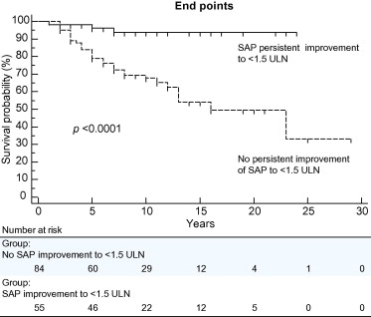
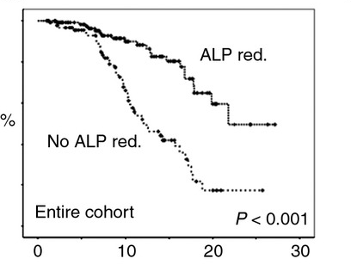
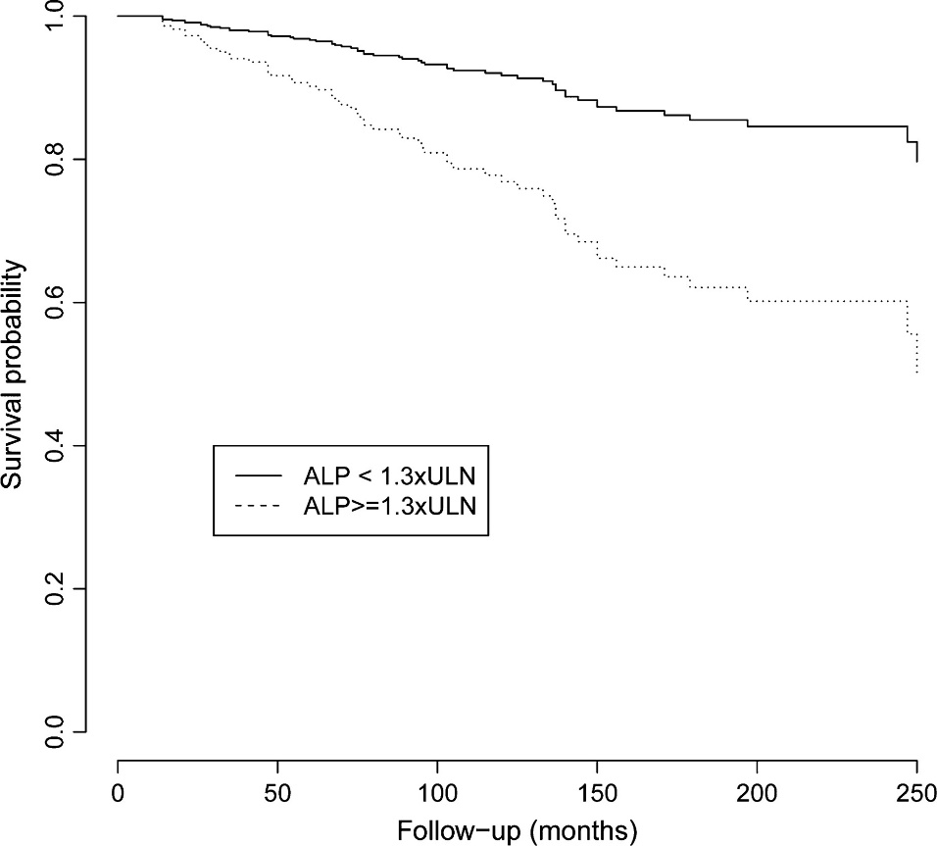
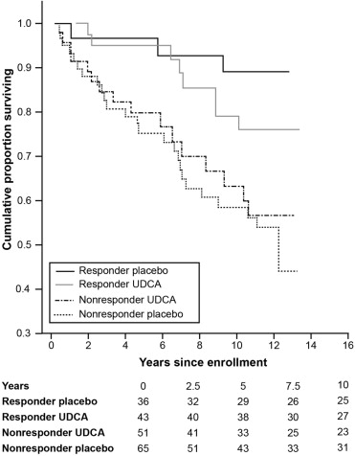
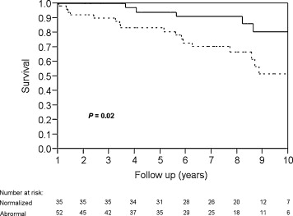
A decrease in alkaline phosphatase is good!
At least 5 studies have confirmed that reduction of alkaline phosphatase is associated with improved survival in PSC
Alkaline phosphatase reduced
Alkaline phosphatase not reduced
Stanich PP, et al. Dig Liver Dis 2011;43(4):309–13
Lindstrom L, et al. Clin Gastroenterol Hepatol 2013;11(7):841–6
de Vries EM, et al. Liver Int 2016;36(12):1867–75
Al MS, et al. J Hepatol 2013;58(2):329–34
Rupp C, et al. Aliment Pharmacol Ther 2014;40(11–12):1292–301
Notes:
Stanich – 87 patients followed for 10 years; those with normalization of alkaline phosphatase had lower rate of liver transplantation, cholangioca, and death
Lindstorm - 198 patients in the 5-year trial of UDCA (n = 97 on UDCA and n = 101 on placebo) performed in 2009–2010 is particularly informative regarding the long-term safety and efficacy of UDCA at doses of 17–23 mg/kg per day.
De Vries study – 336 patients; outcome of PSC-related death and LT evaluated. Association between higher AP levels and reaching endpoint; larger decrease in AP between diagnosis and 1 year decreased event rate
Al MS – 139 patients in Oxford PSC database. Improvement in SAP to below 1.5 ULN is associated with better outcome and reduced risk of CCA in PSC. This was comparable to the achievement of complete normalization of SAP.
Rupp – 215 patients with dominant strictures, Reduction in alkaline phosphatase values within the first year is associated with improved transplantation‐free survival in patients with primary sclerosing cholangitis independent of the presence of dominant strictures.

Slide 15
Effect of UDCA on liver fibrosis
UDCA patients more likely to maintain a lower stage of fibrosis
5 times lower rate of progression from early to late stages with UDCA
Corpechot et al, Hepatology. 2000 Dec;32(6):1196-9.
Notes:
At 4 years, the probability for UDCA-treated patients to remain in the early stage of disease is 76% (95% confidence interval: 58%-88%), as compared with 29%
(15%-52%) in placebo-treated patients.
the rate of stage progression was 7% per year in UDCA-treated patients, as compared with 34% per year in placebo-treated patients

Slide 16
Effect of UDCA on varices
180 patients in controlled trial
EGD performed every two years
139 had no varices on entry
Lower incidence of varices with UDCA after 4 years
Lindor et al., Mayo Clin Proc 1997;72:1137-40

Slide 17
In summary:
UDCA is beneficial for some patients
  Appropriate doses (20mg/kg/day)
  Pre-cirrhosis or early cirrhosis
  Achieve lowering of alkaline phosphatase
Delays progression of fibrosis
Delays development of varices
UDCA should be considered in the algorithm of treatment for PSC
  Should not interfere with enrollment in clinical trials for other novel therapies

