Slide 1
New Paradigms for Transplant Surgery in PSC: MELD and Living Donor Considerations
David C. Mulligan, MD, FACS, FAST
Professor and Chief, Transplantation and Immunology
Yale University/Yale New Haven Health

Slide 2
Primary Sclerosing Cholangitis
    Primarily affects middle-aged men under 45 years of age. Male-Female ratio 2:1
    50-70% associated with Inflammatory Bowel Disease.
    Having family members with PSC may increase a person’s risk of developing PSC.

Slide 3


Primary Sclerosing Cholangitis
What are the symptoms?
  Chronic Fatigue
  Itching
  Loss of appetite
  Weight loss
  Autoimmune problems

Slide 4
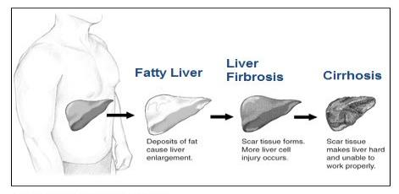
Complications of PSC
  Infections of the Bile Ducts
  Vitamin Deficiencies A, D E & K
  Cirrhosis; extensive scarring of the liver
  Liver Failure
  Cholangiocarcinoma

Slide 5
PSC
Diagnosis
  Confirmed by imaging studies showing a “string of beads” patter of the intra- and extrahepatic bile ducts.
  Risks
  Increased risk of developing cholangiocarinoma, HCC and CRC if found in conjunction with IBD.

Slide 6
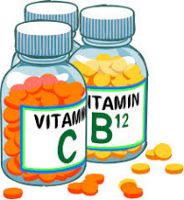
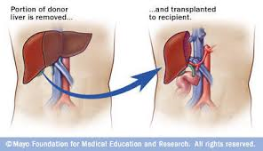
Treatment
Targets symptom relief and manage complications
Medications may include
  Vitamin supplements
  Antibiotics to treat infections
  Medications to relieve itching
  *Liver transplantation may be an option if the liver begins to fail or when symptoms are severe

Slide 7
Liver donations in the US
Scarcity of donor organs
Over 120,386 patients on the waitlist in the US
  14,697 patients are waiting for a liver
Over 6,622 deceased donor and 359 living donor liver transplants performed in 2015
More than 2,894 people die each year waiting for a liver transplant
That’s about 20 people receive transplants and 8 people die/day waiting for a life-saving liver transplant
https://optn.transplant.hrsa.gov/data/view-data-reports/national-data/# June 17, 2016

Slide 8
Allocation and distribution of organs
Efficiency
  Achieve efficiency in organ offers, acceptances, procurements, distribution, transport
Maximize utility and benefit
  Direct organs to those most in need
  Avoiding Futility
Fairness and justice
  Equity in access to organs for patients with similar degrees of illness and urgency
  Regardless of race, gender, geography

Slide 9
History of U.S. liver allocation changes
Feb 2002 - MELD score replaces Status 1, Status 2a, 2b , Status 3 and wait list times at status, more objective criteria
  Better transplant outcomes, despite sickest first triage
  Lower waitlist mortality
1999 Regional Sharing agreements for Status 1 patients in Regions 4,7
  Significant reduction in waitlist mortality for acute liver failure
2005 – Regional Share 15
2010 – Regional Sharing for status 1 patients across all UNOS regions
  Reduction in waitlist mortality for status 1 pts, especially peds

Slide 10
Most recent allocation changes
June 2013 – Regional Share 35/National Share 15
  Decreased wait time, increased access and decreased waitlist mortality for candidates with MELD>=35
October 2015 - HCC cap and delay
  6 month delay before HCC points awarded
  HCC exception points: capped at 34
  Ask for lab MELD score original and 1st recertification applications, request 28 points for 2nd recertification, etc
  Do not ask for more than 34 points without justification for increased score
Jan 11, 2016 – MELD Na
  Programs should identify patients who will go up in MELD (Na <137 mEQ/L – increase will be 0-11 points ) and change lab update schedule (especially up to 25+)

Slide 11
What have we observed after Share 35?
More liver transplants performed
Higher percentage of pts with MELD 35+ transplanted
Wait list mortality for THIS group of patients decreased significantly
Overall wait list mortality decreased slightly
Post transplant graft and patient survival was unchanged overall and for the MELD 35+ patients
Increased regional sharing (20.8% to 32.0%)
Variance in median MELD at transplant increased
Variance in transport time increased
Cost for sharing more livers increased
Decreased overall discard rates

Slide 12
Competing Risk Liver Waiting List Outcome Probabilities at 1-Year
Candidates Added 2007-2010
N=10319
N=15810
N=2363
*Status 1A/1B, and candidates with exceptions excluded

Slide 13
Deceased Donor Liver Transplants by Era and Region Median Allocation Score At Transplant
(Status 1s Excluded)
US Overall
Pre-Era: 27
Post-Era: 28
Pre:6/18/2011-6/17/2013 Post:6/18/2013-12/17/2015
Notes:
Overall MELD at transplant score increased by 1 point

Slide 14
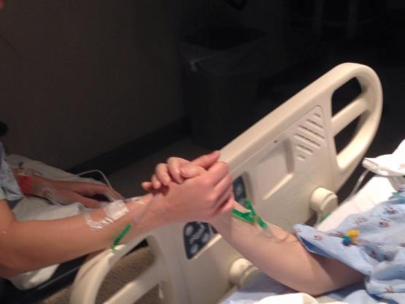
So, what can be done?

Slide 15
Stepwise Donor Evaluation
Phone interviews and lab data
Education about the risks of living donation
ABO compatible and </= 60 years old
Usually close family members or friends, some centers use anonymous nondirected donors.
Review with hepatologist and surgeon
Onsite evaluation with physician, surgeon, coordinator, social worker, independent donor advocate and psychiatrist
Radiologic evaluation (CT angio and MRCP)
Liver biopsy – optional last step if all else OK
Notes:
In order to fully understand the extra support required for LDLT, let’s walk through the process involved.

Slide 16
Donor selection is key for successful LDLT
Right Lobe – Outflow Challenged
Left Lobe – Size/Volume Challenged

Slide 17
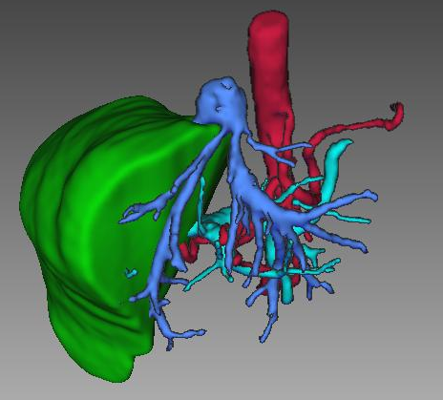
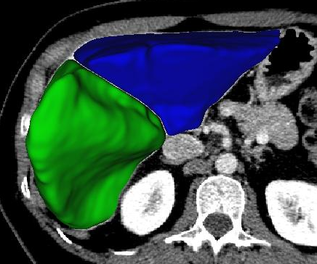
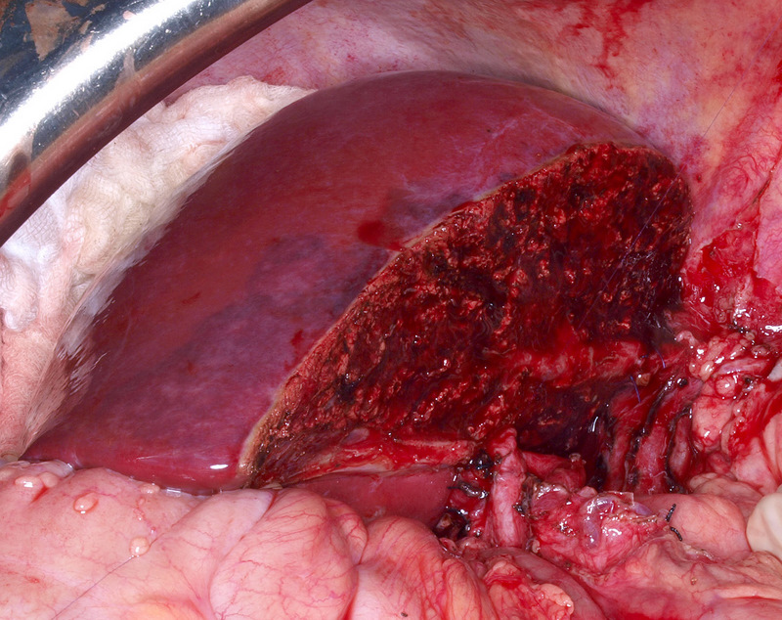
Virtual Planning of Hepatectomy
Surgeon and Radiologist carefully plan donor hepatectomy preoperatively
  Cut plane, MHV’s, biliary and arterial anatomy, volumetric analysis

Slide 18
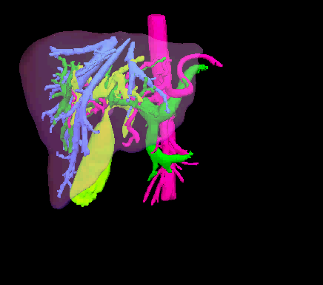
Precision Liver Surgery
Real-time 3D quantitative analysis of:
  Intra-hepatic anatomies
  Spatial relationships
Based on advanced segmentation:
  Confirmed / adjusted on original CT
  “Virtual” Surgical plans modeled
  Volumes calculated
    Surgeons individualize
    & finalize surgical plans
    in minutes

Slide 19
Donor Outcomes
Donor hepatectomy can lead to death or serious complications, including liver failure….at least 6 living donors have undergone rescue liver transplantation and only 2 survived
Risk increases with increasing hepatic mass resected above 70%, but recent study of 4111 patients undergoing donor hepatectomy showed no difference in donor mortality between left lobe and right lobe donation (0.2 and 0.3%)
Of approx. 6000 donor hepatectomies worldwide, there have been 13 deaths (0.2%)
Median complication rate was 16%
  Predominant biliary leaks/strictures(6%) and infections(6%)

Slide 20
International Liver Transplant Society Meeting 2011
Web-based survey of clinical practices related to LDLT:
71 centers representing LDLT programs in North America, Europe, Asia, South America, Australia, New Zealand, and the Middle East
23 donor deaths out of a total of 11,553 LDLT procedures 18 of the deaths reported directly in the survey, and another 5 deaths were reported by the Eurotransplant Registry overall mortality rate of 0.2%
No differences in the death rates between the hepatectomy types
  18/8734 for right lobectomy (RL)
  2/994 for left lobectomy (LL)
  3/2168 for LLS
  P = 0.71 for RL versus LL, P = 0.71 for RL versus LLS, and P = 0.65 for LL versus LLS
Another 11 deaths after donor hepatectomy have been reported in the literature, but they were not captured in the survey
Notes:
In a recent worldwide survey reported at the 2011 International Liver Transplant Society Meeting,[7] all liver transplant programs listed with the American Society of Transplant Surgeons, the Japanese Liver Transplant Society, and the European and Chinese liver registries were asked to complete a Web-based survey regarding their current clinical practices related to LDLT. Responses were received from 71 centers representing LDLT programs in North America, Europe, Asia, South America, Australia, New Zealand, and the Middle East. There were 23 donor deaths out of a total of 11,553 LDLT procedures. Eighteen of the deaths were reported directly in the survey, and another 5 deaths were reported by the Eurotransplant Registry for an overall mortality rate of 0.2%. There were no differences in the death rates between the hepatectomy types [18/8734 for right lobectomy (RL), 2/994 for left lobectomy (LL), and 3/2168 for LLS; P = 0.71 for RL versus LL, P = 0.71 for RL versus LLS, and P = 0.65 for LL versus LLS]. Another 11 deaths after donor hepatectomy have been reported in the literature, but they were not captured in the survey.[8-18] Twenty-four of the total 34 reported deaths occurred in RL donors.

Slide 21
Conclusions of A2ALL Long Term Outcomes
There is a significant and sustained benefit to liver transplant candidates with LDLT compared with DDLT
  This benefit occurs not only during the waitlist period but also by providing real benefit after transplantation by offering transplantation at a lower MELD, before disease progression associated with renal dysfunction and other life support requirements
Some of the risk factors contributing to poor outcome, such as renal failure, can be avoided if LDLT can be performed in a more timely fashion than DDLT
Early graft failure and patients’ mortality experienced by centers starting LDLT programs markedly improved after the first 15 to 20 procedures, true for both A2ALL and non-A2ALL centers
Dysfunction of the segmental graft, or “small-for-size syndrome,” remains a significant concern and the biliary reconstruction and postoperative complications continue to be the Achilles heel of LDLT
When a deceased donor organ is not immediately available, as is usually the case, LDLT should be considered a primary liver transplant option early in the course of transplant evaluation
  even status 1 and high MELD patients likely benefit from LDLT

Slide 22
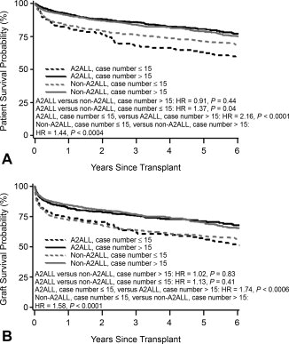
Outcomes of adult living donor liver transplantation: Comparison of the adult‐to‐adult living donor liver transplantation cohort study and the national experience

Slide 23
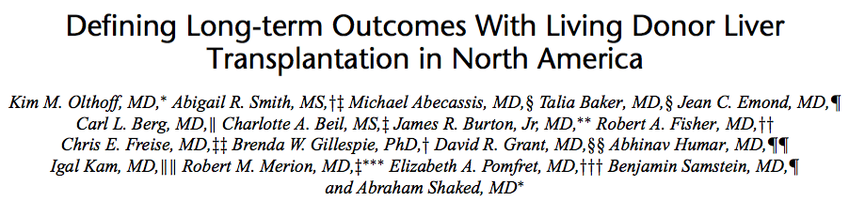
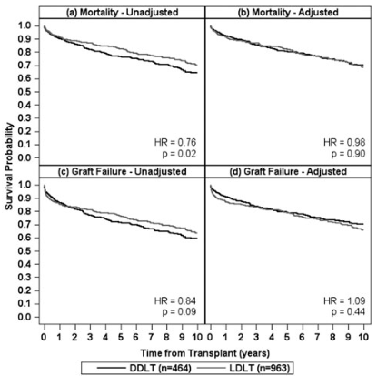
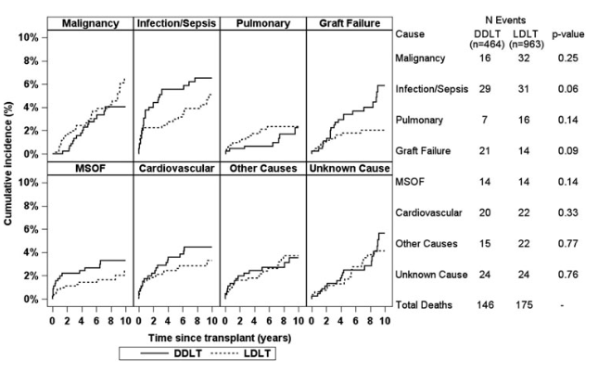

Slide 24
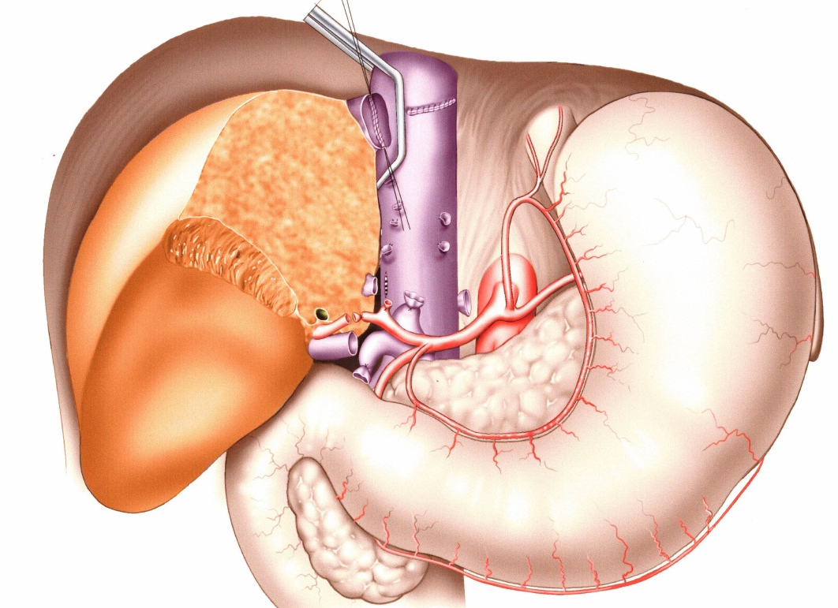
Right Lobe Transplantation
Similar to Deceased Donor Liver Transplantation except:
  IVC must be preserved
  Possible extra Hepatic vein implantations
  Use extra length of hepatic arteries, portal vein, and hepatic ducts

Slide 25
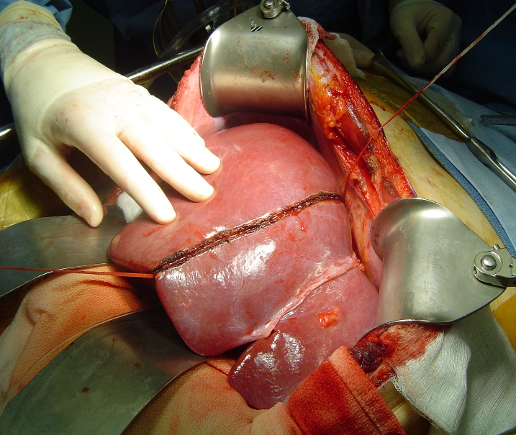
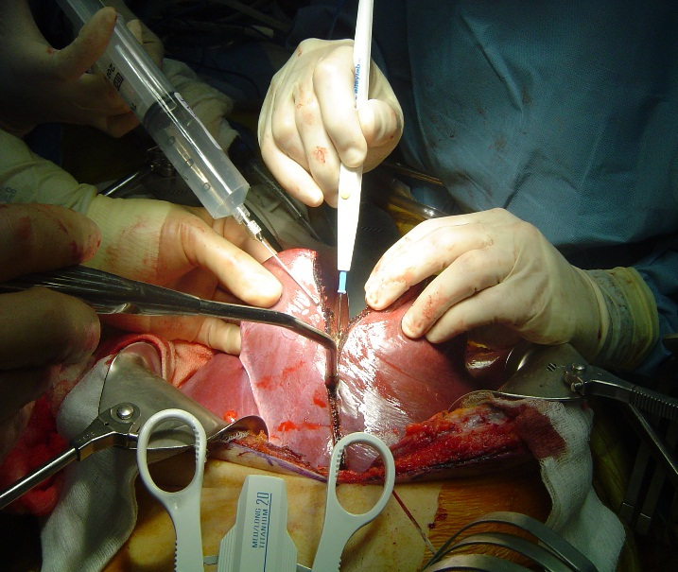
Left Lobe Transplantation
Decision regarding the need for left lobe vs. left lateral segment transplant needed
MHV removed with the graft when full left lobe is used
Deceased donor vessels used when artery extensions required and/or for portal vein reconstruction
Graft positioned at 45 degree angle to protect venous outflow

Slide 26
LDLT at Mayo Clinic Arizona
3/2001 to 8/2013
135 LDLT (51% women, 49% men)
    Mean age 37.3yrs (18 – 56yrs)
    133 right lobes
    2 whole organ (domino transplant)
Donor Survival 100%
  Complications – using A2ALL class
    Predominantly grade 1 (27.4%)
    Single case grade 4a (0.7%)
    No blood transfusions

Slide 27
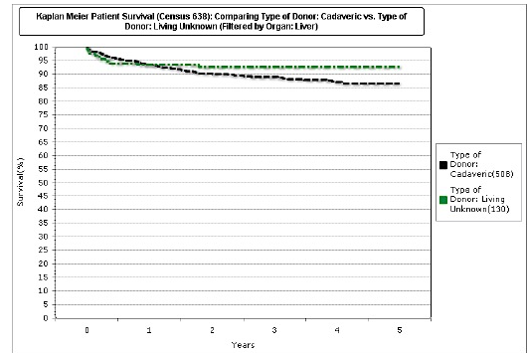
MCA Living Liver Recipient Survival

Slide 28
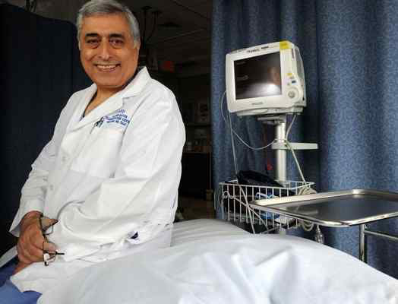
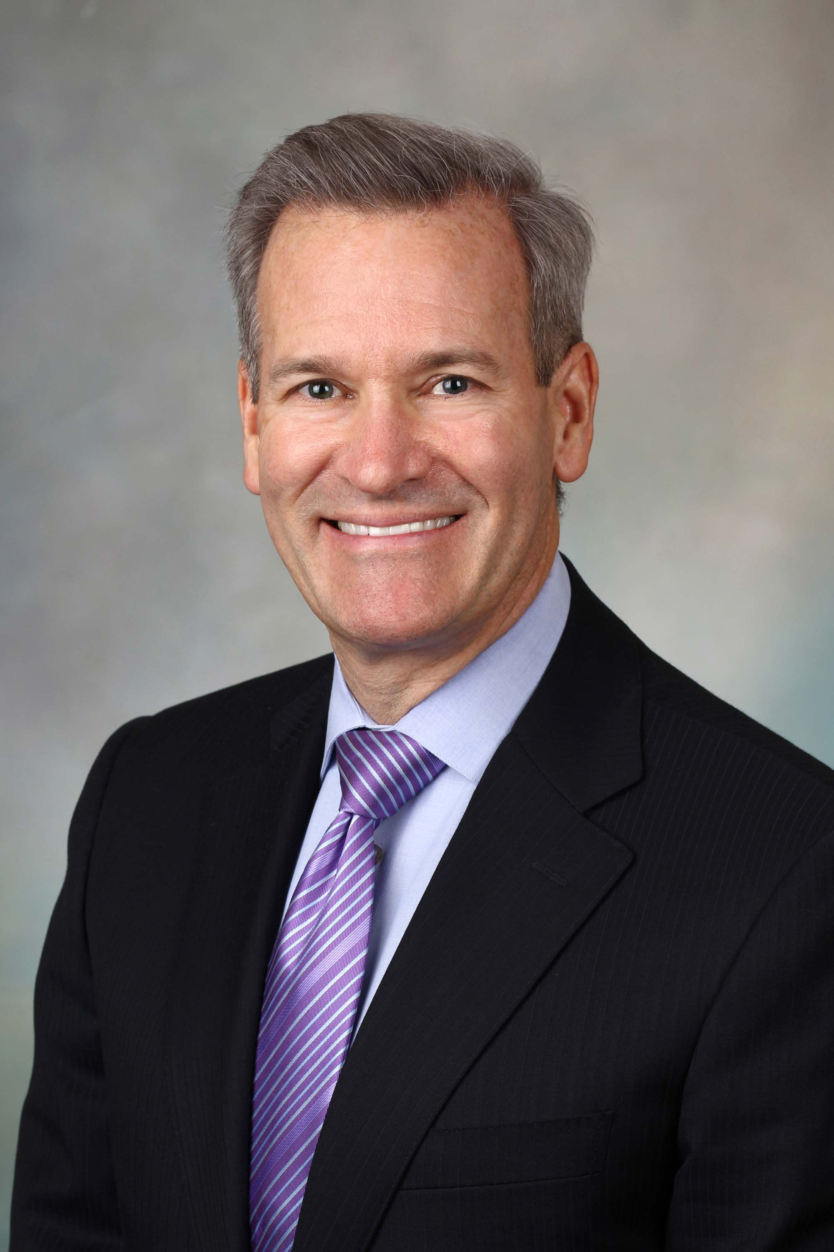
LDLT at Yale New Haven
2 World renowned transplant surgeons at Yale:
  Dr. Sukru Emre MD
  Professor or Surgery Transplant and Pediatrics
  Dr. David Mulligan MD, FACS
    Professor of Surgery
    Chief, Section of Transplantation and Immunology
  Each with over 200+ Liver donations cases

Slide 29
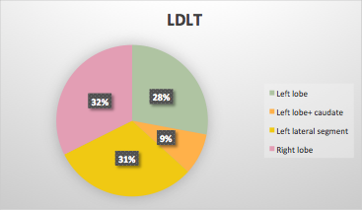
Outcomes of LDLT at Yale University/Yale New Haven Hospital
Total: 75 patients
Pediatric (0-18 y) 35
Adult 40
Left resections 48
Right resections 27
Total Living donors
(Jan 208-May 2016)
2016: 5 ongoing
2013: 8
2012: 12
2015: 11
2014: 4
2011: 8
2010: 16
2009: 7
2008: 6

Slide 30
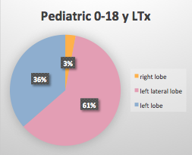
Pediatric Recipients of LDLT at Yale
Pediatric
Total 35
F 17
M 18
Median age 6.1 yo
Diagnosis
PSC 2
Biliary atresia 11
Biliary cirrhosis 1
Cystic Fibrosis 1

Slide 31
Adult Recipients of LDLT at Yale
Relationship between Donor/Recipient:
Siblings: 9
Parent: 30
Friend: 6
Altruistic: 5
Aunt: 8
Adult patients (over 18) Total 38
PSC 10
HCV 10
HBV 1
ETOH 1
Vascular malformation 2
NASH 2
PBC 2

Slide 32
Statistics
At a Glance:
As of June 30, 2015, the percentage of recipients who were still living 5-years after their liver transplant.
  Liver (deceased donor) 90.99%
  Liver (living donor) 96.47%

Slide 33
Case MR
33 year old Male, waiting 5 years for liver transplant
  Abnormal Liver tests
  AKI/Hyponatremia
Signs and Symptoms
  Jaundice
  Itching
  Recurring umbilical hernia with ascites
Blood tests, biopsy, CT Scan
Diagnosis:
  End Stage Liver Disease due to Primary Sclerosing Cholangitis
  Unfortunately, despite progressive deterioration, muscle wasting prevented creatinine elevation making MELD peak at 27

Slide 34
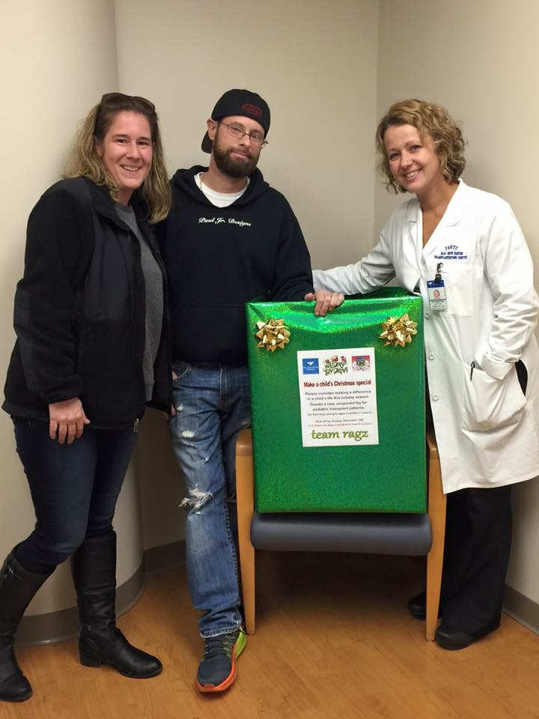
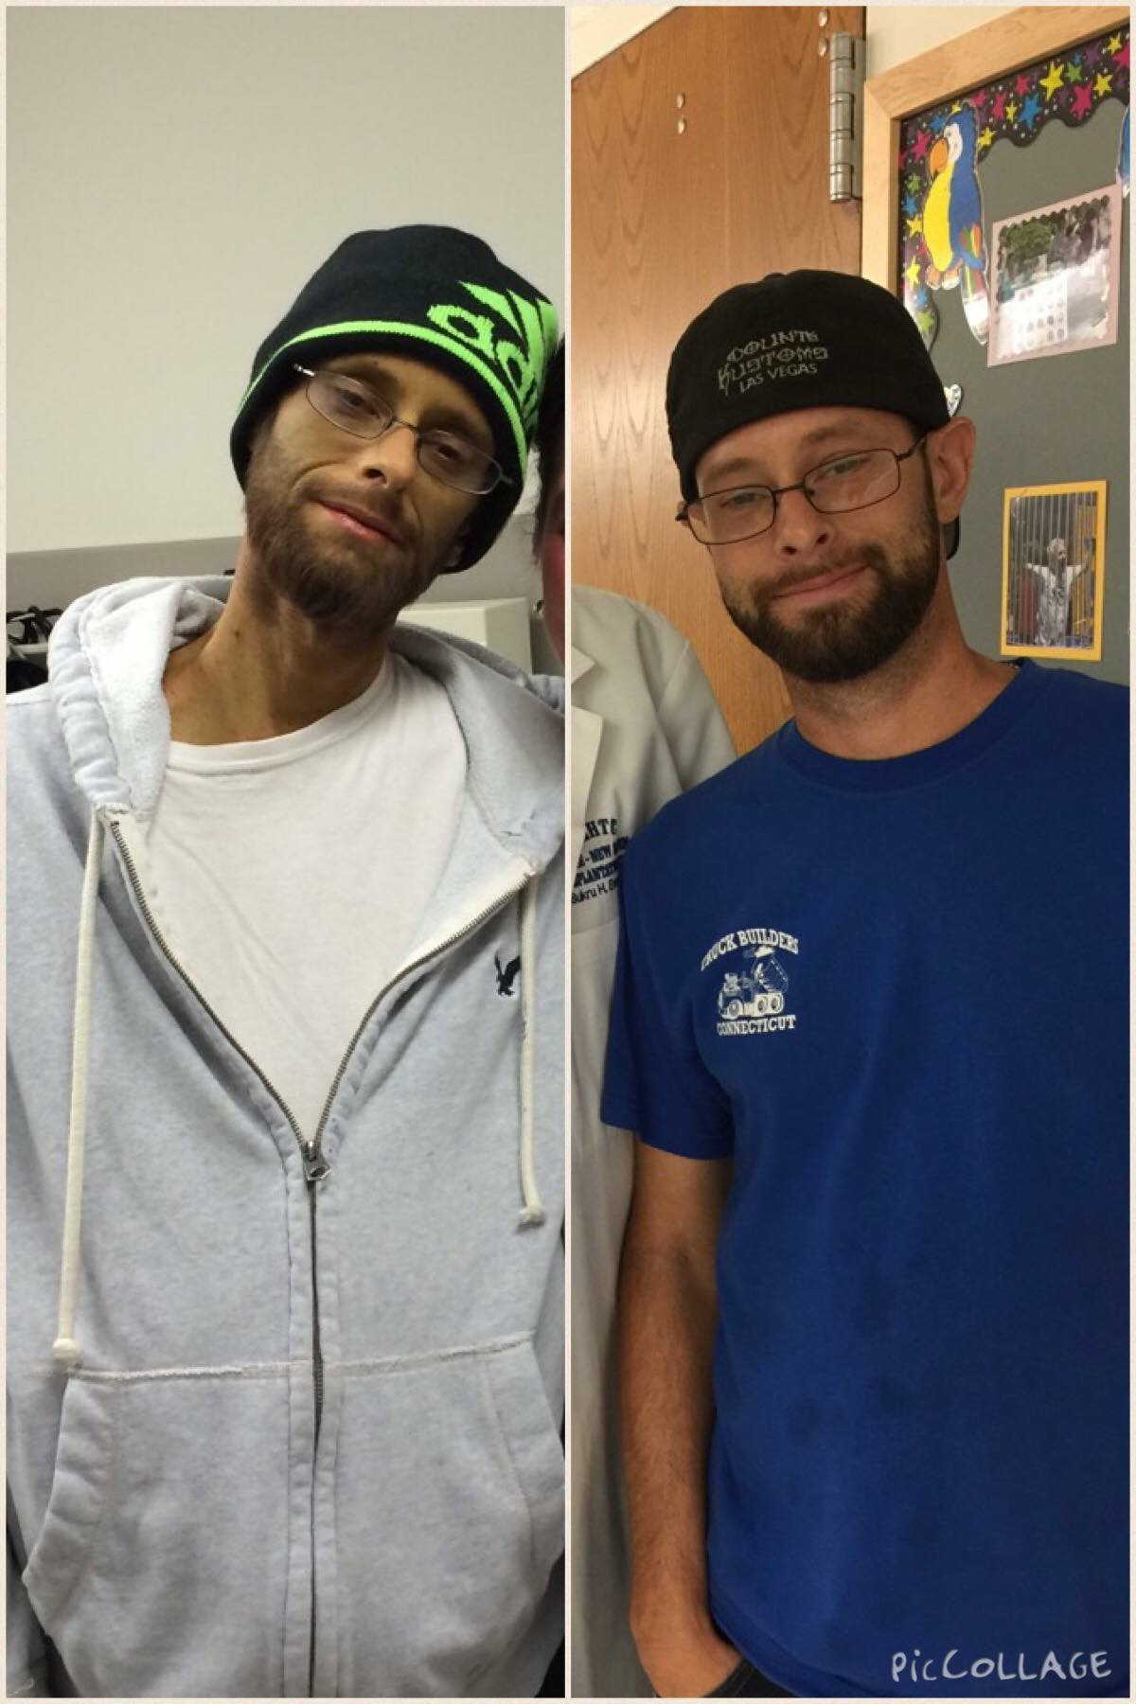
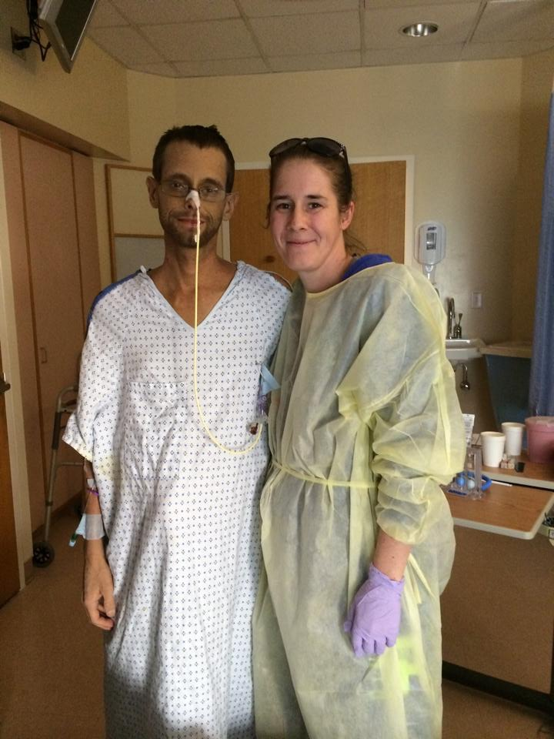

Slide 35
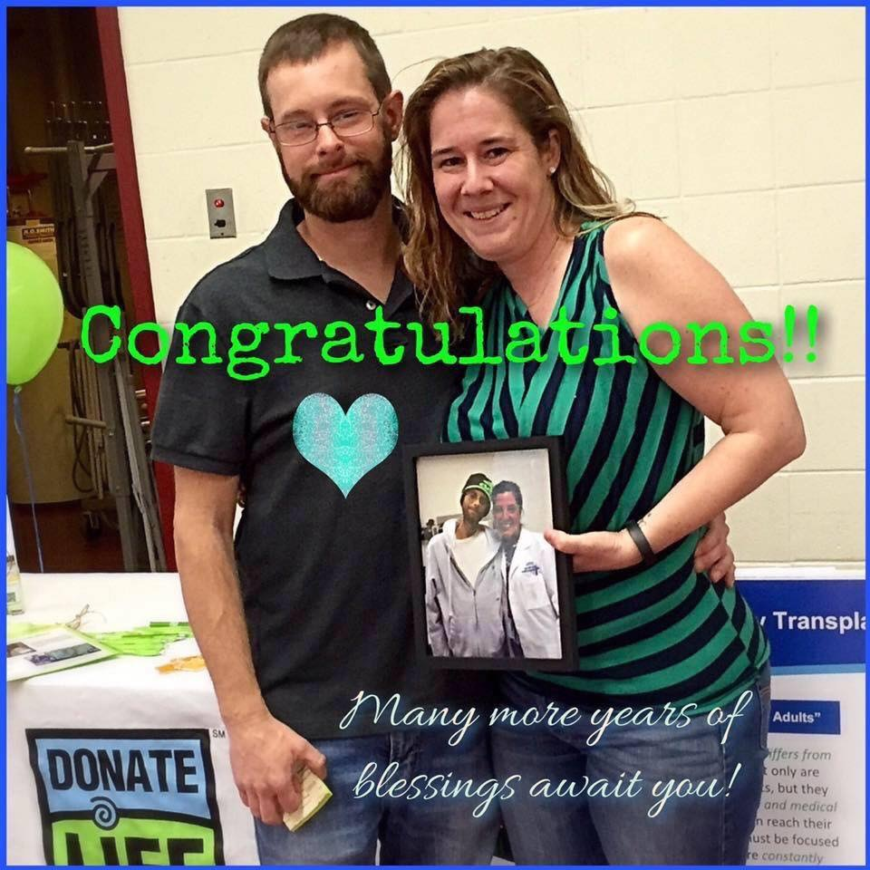
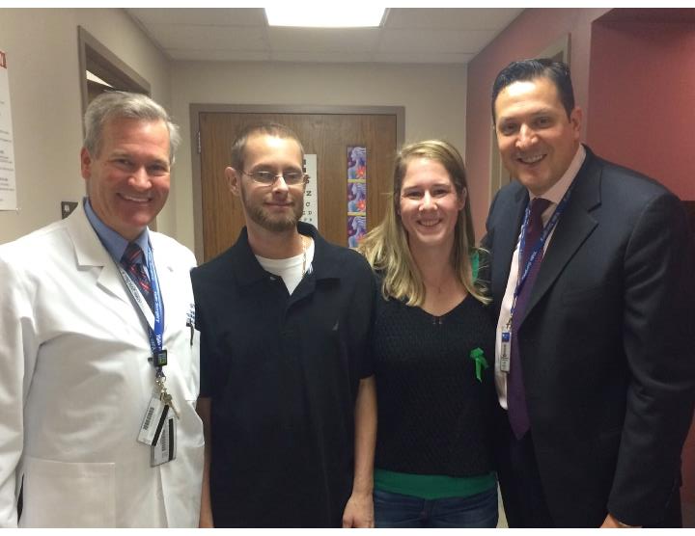
Great Living Donor Advocates

Slide 36
Take Home Message
Live donor liver transplants can be performed with excellent donor and recipient outcomes and has become an accepted practice, especially for pediatric liver transplantation due to the low risks
Steep learning curve mandates that only experienced hepatic surgeons in academic medical centers perform LDLT’s
When a deceased donor organ is not immediately available, as is usually the case, LDLT should be considered a primary liver transplant option early in the course of transplant evaluation
Patients with PSC are ideal candidates for LDLT as it is often difficult to develop competitive MELD scores

Slide 37
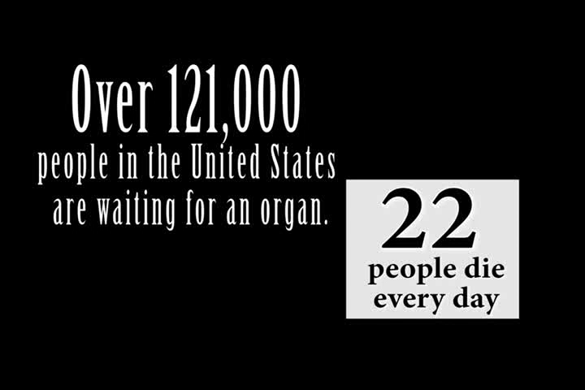

Slide 38
Thank You!

