Slide 1
Liver Transplantation in PSC: What to Know and Recent Updates
Brett E. Fortune, MD, MSc
Assistant Professor of Medicine and Surgery
Yale School of Medicine
Yale-New Haven Transplantation Center

Slide 2
Case
MR is a 45 y.o. male with cirrhosis secondary to PSC and has features of decompensated cirrhosis including tense ascites, hepatic encephalopathy, and had a history of upper gastrointestinal bleeding.
SHOULD I REFER TO A LIVER TRANSPLANT CENTER? IF NOT, WHEN?
IF SO, WHAT ARE THE CHANCES TO RECEIVE A TRANSPLANT AND CAN YOU SURVIVE?

Slide 3
Agenda
Indications for referral to a liver transplant center for Primary Sclerosing Cholangitis (PSC)
Cholangiocarcinoma
Organ accessibility for patients with PSC
Living donor liver transplant (LDLT)
Outcomes for patients with PSC while on wait-list
Brief mention of post-transplant outcomes
Next talk by Dr Cary Caldwell to discuss medical management

Slide 4
Indications for referral to transplant
When to refer patients with PSC to a transplant center?
Usually 15-25 years after initial diagnosis
Less than 5% of all LTx (prevalence 10 cases per 100,000 people for PSC)
Development of cholangitis from stricture, particularly if present with:
recurrent cholangitis
Bacteremia
Development of complications related to cirrhosis / portal hypertension
Ascites
Hepatic encephalopathy
Variceal hemorrhage
Severe jaundice
Martin P, et al. Hepatology 20103

Slide 5
Indications for referral to transplant
Cholangiocarcinoma (some regions)
May require therapies prior to transplant
Only hilar tumors (Klatskin tumor)
Severe decrease in quality of life
Failure to thrive
Pruritus/jaundice
Malnutrition
Drains/stents/antibiotics
Martin P, et al. Hepatology 20103

Slide 6
Liver Transplant evaluation
Imaging
Labs
Colonoscopy (IBD mgt)
Mammogram/pelvic exam (if female)
Psychosocial evaluation
Nutrition evaluation
Pharmacy
Cardiology evaluation and testing
Infectious disease consultation
PFTs

Slide 7
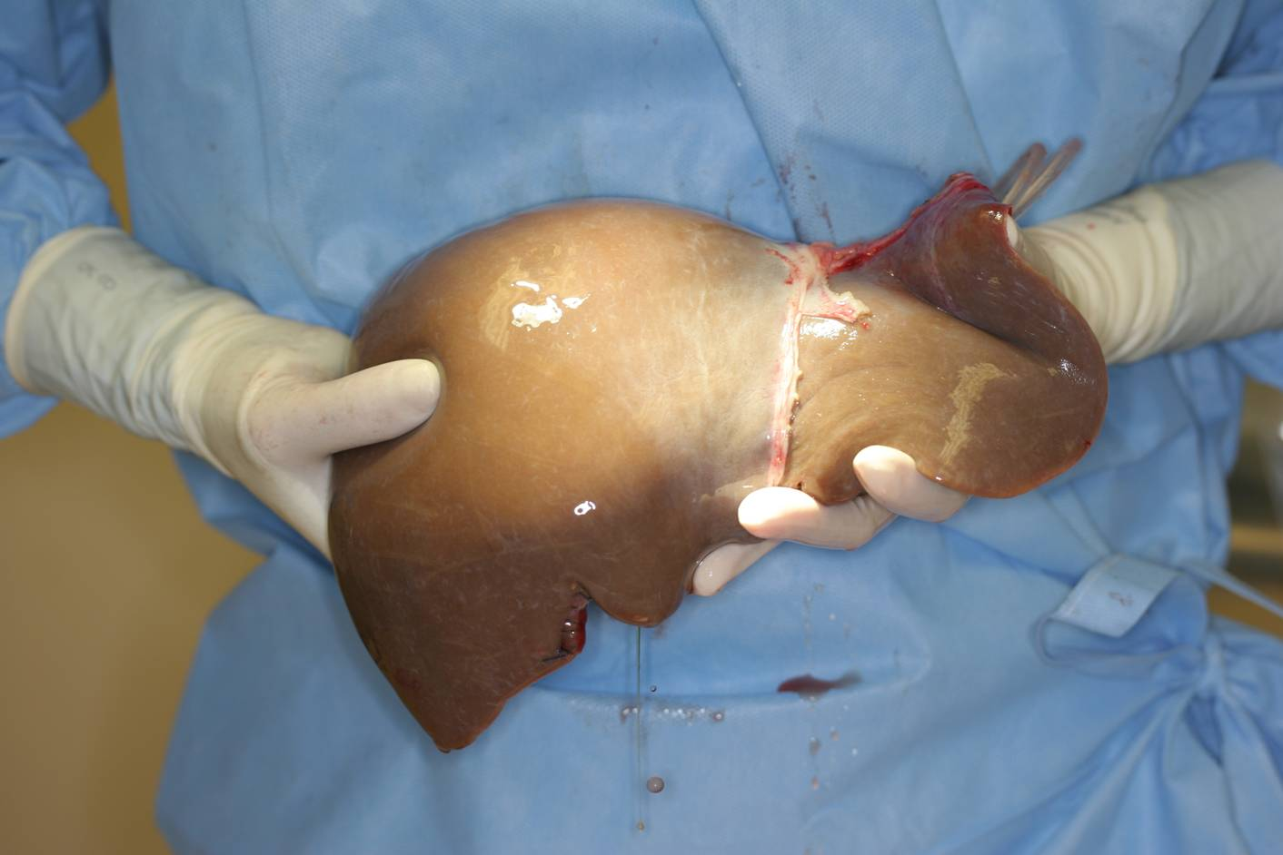
Benefits of Liver transplant for patients with PSC
Liver transplantation is the best option to treat patients with advanced PSC and complications related to cirrhosis
Improved survival after transplant
Greater than 90% 5-year survival!!
Lower with tumor

Slide 8
Frailty in liver transplantation
Conditioning is critical for survival!
Nutrition status
Cholestatic liver diseases cause multiple nutrient and vitamin deficiencies
Severe malnutrition
Complicated if accompanied with bowel disease
Severe bone disease associated with cholestatic liver diseases
Deconditioning
Physical and occupational therapy
Infection risk
Cholangitis episodes
Any manipulation of bile ducts (ERCPs)
Presence of severe dominant stricture or tumor

Slide 9
Organ Access to patients with PSC
Current liver organ allocation system uses the Model for End-stage Liver Disease (MELD) score to prioritize patients for organs
Transplant the “sickest first”
Uses lab values to compute score (range 6-40+)
Total bilirubin
Creatinine
INR (international normalized ratio)
(recent update) Sodium
Total bilirubin has the lowest coefficient and thus cholestatic liver diseases have been felt to be disadvantaged for liver transplant organ allocation
MELD Score =
10 * ((0.957 * ln(Creatinine)) + (0.378 * ln(Bilirubin)) + (1.12 * ln(INR))) + 6.43

Slide 10
Outcomes of patients with PSC on the wait-list for transplant
PSC was not associated with death or wait-list removal
Age, MELD were predictors
Goldberg D, et al. Liver Transplant 2011

Slide 11
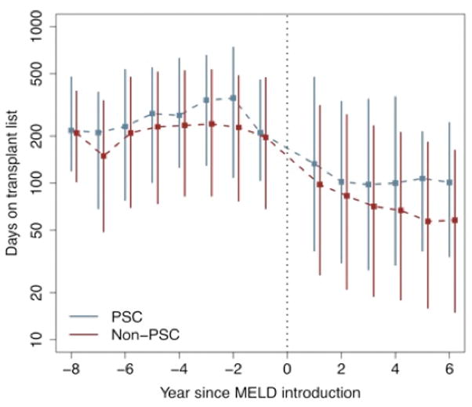
Trends to use LDLT for PSC – Impact of MELD
PSC patients were more likely to receive a LDLT in both eras, but even more so in post-MELD era
4x more likely than other indications for LDLT
Goldberg D, et al. Transplantation 2011

Slide 12
Lack of standardization to use MELD exception points for PSC/cholangitis
Jan 2007, passed recommended criteria (MESSAGE criteria) for MELD exception due to recurrent bacterial cholangitis for patients with PSC
Recurrent cholangitis
2 episodes of bacteremia
1 episode of abscess/sepsis
Dependence on antibiotics/stenting
Increased approval for applications but less MELD points allotted.
Regional variation
Goldberg D, et al. Am J Transplant 2012

Slide 13
Cholangitis/recurrent cholangitis does NOT impact patient pre-transplant survival
Two center study investigating the outcomes of patients with PSC on the wait-list and the impact of bacterial cholangitis
UPENN and UColorado, 2002-2012
N=171 patients, 39% had prior cholangitis episode prior to wait listing
48% had at least one episode prior to transplant (greater number at UCD)
Competing risk Cox model, multivariable
History of any episode of cholangitis, sHR 0.67; 0.65 – 0.70, p<0.001
History of cholangitis prior to listing, sHR 1.0; 0.60-1.66, p=0.99
History of cholangitis while on list, sHR 0.39; 0.16 – 0.93, p=0.03
Goldberg D, et al. Liver Transplant 2013

Slide 14
Outcomes for patients transplanted for PSC
Graft and patient survival
UNOS / SRTR data
Risk of disease recurrence
20%-25% in 5-10 years post-transplant have PSC recurrence
Reported increased risk for acute cellular rejection and chronic rejection
Outcomes for bowel disease
Increased risk for active disease (especially if active prior to IBD)
Need for proctocolectomy for those with UC?
Differences in immunosuppression
Prolonged use of corticosteroids

Slide 15
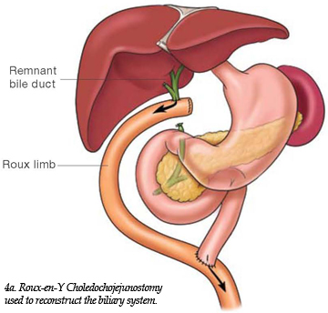
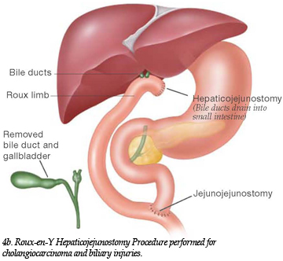
Liver transplantation for PSC
Typically use Roux-en-Y choledochojejunostomy with resection of the native common bile duct is standard approach
Other options
Hepaticojejunostomy
Duct-to-duct biliary reconstruction if native CBD is clear of disease
Bilioenteric techniques are associated with a higher incidence of cholangitis

Slide 16
Living Donor Liver transplant in patients with PSC
A2ALL cohort, 1427 liver transplant recipients, 963 LDLT
223 patients transplanted for PSC
162 patients received LDLT
PSC was a predictor for both graft (HR 0.66, 0.47-0.93, p=0.02) and patient survival (HR 0.45, 0.30-0.69, p<0.001)
Cancer other than HCC (CCA) associated with increased mortality
Olthoff K, et al. Annals of Surgery 2015

Slide 17
Superior Survival in LDLT for PSC/cholestatic liver disease
UNOS/OPTN database study
2,103 LDLTs and 44,512 DDLTs (N=46,615) between 2002-2012
4,009 transplants for cholestatic liver disease (25% of all LDLTs)
Outcomes: 75-79% 3-yr survival for all transplants (higher for LDLT patients at experienced LDLT centers [>15 LDLT])
 | Hazard Ratio (95% CI) | P-value
Cholestatic liver disease
DDLT | 1.0
LDLT ≤ 15 | 1.36 (0.83 – 2.22) | 0.22
LDLT > 15 | 0.75 (0.63 – 0.92) | 0.004
Autoimmune liver disease
DDLT | 1.0
LDLT ≤ 15 | 0.87 (0.35 – 2.15) | 0.76
LDLT > 15 | 0.56 (0.37 – 0.83) | 0.004
Goldberg D, et al. Hepatology 2014

Slide 18
Recurrent PSC after transplant
Remains controversial on predictors and how to manage patients to prevent disease after transplant
Studies have shown a higher incidence of recurrent PSC
Impact of immunosuppression
Effect of colectomy and timing
Pre-transplant or during transplant colectomies had lower incidence of recurrent PSC compared to those with colon intact or had post-transplant colectomy
Very difficult to distinguish between recurrent PSC vs. other cause of cholangiopathy (such as chronic rejection)

Slide 19
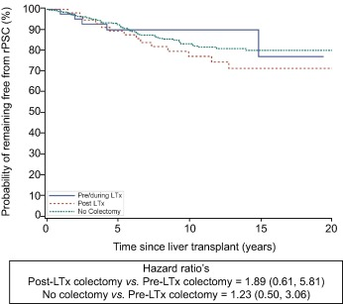
Recurrent PSC after transplant
N=679 patients
Ravikumar R, et al. J Hepatology 2015

Slide 20
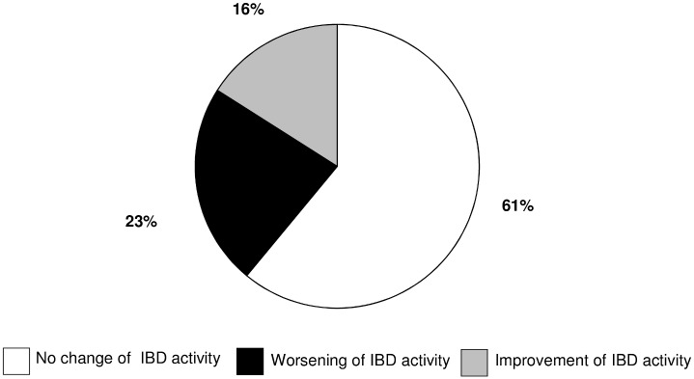
IBD outcomes after LTx
German Cohort of 1537 patients with IBD and 31 who received LTx
84% survival rate after median 103 months of follow up
65% of patients were in remission prior to LTx
Schnitzier F, etal. Plos One 2015

Slide 21
IBD outcomes after LTx
Active IBD prior to LTx
Adversely affect LTx outcomes
Endoscopic surveillance in 1- to 2-year intervals prior to LTx and after LTx given increased risk for cancer
Poorly controlled IBD
Higher risk for thrombotic episodes
Decreased graft survival
Optimize control of IBD PRIOR TO LT!!!!
Joshi D, et al. Liver Int 2013

Slide 22
Colon cancer after Liver transplant for PSC
Systematic review and Meta-analysis of 18 cohort studies
69 cases of CRC in 1987 patients
Incidence rate of CRC in patients with PSC after LT
5.8 per 1000 patient-years
Incidence rate of CRC in patients with PSC and IBD after LT
13.5 per 1000 patient-years
Predictors :
Long duration of IBD and extensive colitis
Singh S, et al. Liver Transplant 2013

Slide 23
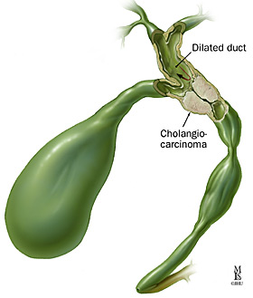
Cholangiocarcinoma (CCA)
Cumulative risk – 5-10% over 10 years
Difficult to diagnose
CA19-9 marker
ERCP
Cholangioscopy/ FNA/biopsy
Intraductal ultrasound
FISH studies
Hilar (Klatskin) tumors
Most studied for use of LTx

Slide 24
Cholangiocarcinoma (CCA)
Intrahepatic CCA is controversial
Associated with increased risk for tumor recurrence after transplant
Increased risk for death
Regional and center dependent
Regions may require response to neoadjuvant chemoradiation protocols pre-transplant for CCA cases
Murad D, et al. Hepatology 2012

Slide 25
Liver Transplant for Cholangiocarcinoma
Unresectable tumor or patient with severe liver disease
Tumor characteristics for liver transplant (eligible for MELD prioritization)
Single mass ≤ 3cm with intrahepatic or extrahepatic metastases
Neoadjuvant therapy prior to LT
Experienced centers
External beam radiation
Chemotherapy
Reported 5-year survival rates for these patients ~ 70% (compared to 2-year survival of less than 20% without transplant)
ALWAYS CONSIDER RESECTION IF PATIENT DOES NOT HAVE advanced liver disease and mass is acceptable for resection
Rea D, et al. Ann Surg 2005
Chapman R, et al. Hepatology 2010

Slide 26
Summary
PSC, in the setting of advanced liver disease, can be treated with excellent long term outcomes using liver transplantation.
Patients with PSC do not die from infection but complications related to their advanced liver disease
With the MELD era, patients with cholestatic liver disease are LESS likely to receive a DDLT
Trend to have LDLT – thus, resulting in superior outcomes using LDLT
Recurrence of disease can occur after transplant

Slide 27
Future Directions
Develop effective therapies to PREVENT progression of PSC
Thus reduce the need for transplant
Improve patient selection/timing for transplant as well as donor selection
Improve mgt after transplant (prevent disease recurrence)
Impact of IBD/intact bowel – timing of surgery if any?
Immunosuppression regimen

Slide 28
Yale New Haven Transplant center
Excellent experience in living donor transplant
World class living donor team and transplant surgery
Top 1% in transplant outcomes
If any questions, please ask and happy to provide more information

Slide 29
Questions?

